Slide 1
Notes:
Example of presentation intro slide, also same intro slide used for video. You may add your logo to the RIGHT of the Horticulture Innovation Lab 3-logo block and CENTER it below Feed the Future logo.

Slide 2
Locally led, globally supported
Management entity based at the University of California, Davis
Regional Hubs in East and West Africa, Central America and South Asia
based at International Center for Evaluation and Development, University of Ghana, Zamorano University and FORWARD Nepal
Notes:
Another example of placing logo and spacing to read “FEED THE FUTURE Innovation Lab for Horticulture” – given proper spacing – so as not to have to repeat “Feed the Future” in text and appear redundant, see Feed the Future guidelines p. 8 on this: www.feedthefuture.gov/resource/feed-the-future-graphic-and-naming-standards-manual/

Slide 3
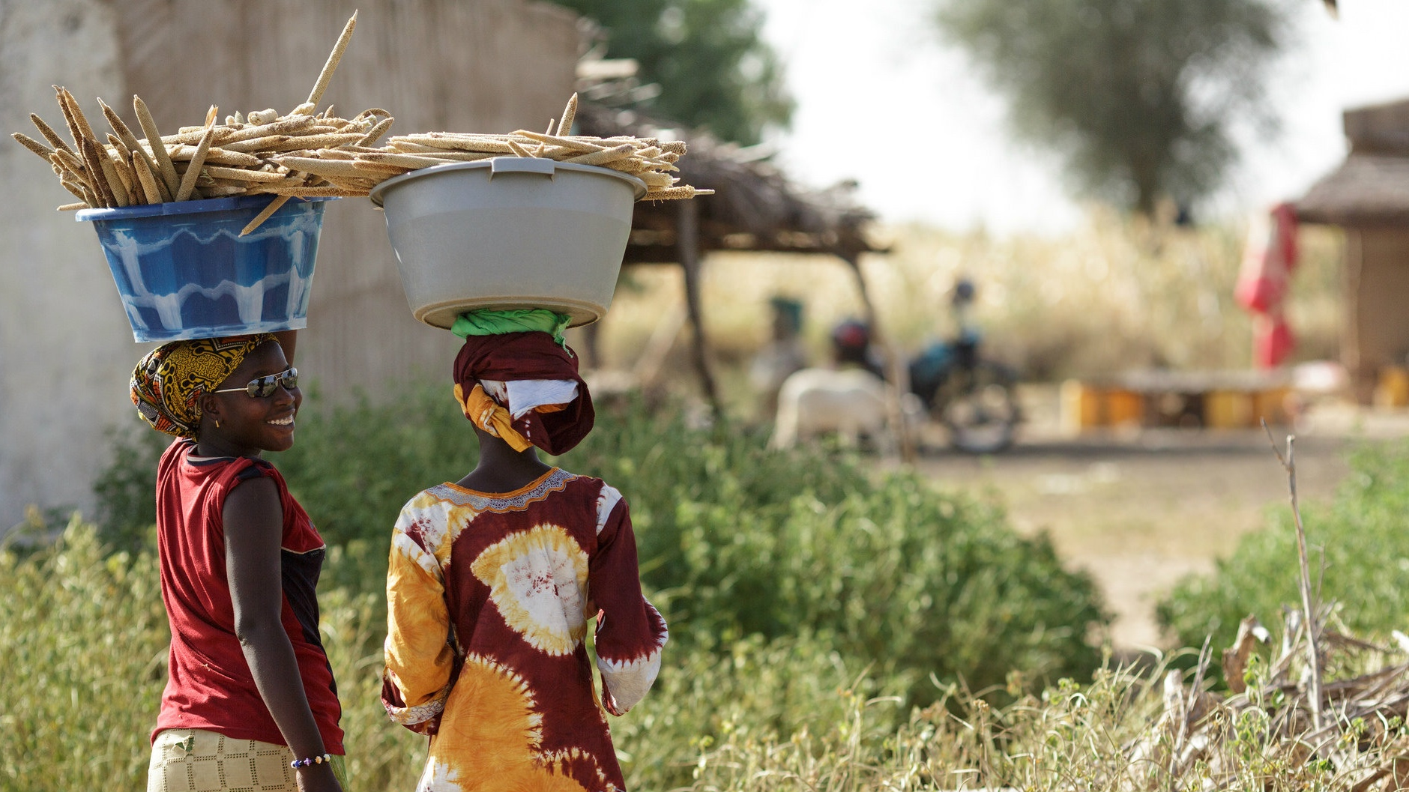
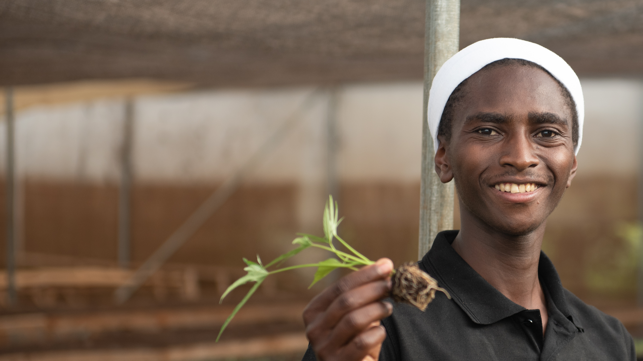


Feed the Future Innovation Lab for Horticulture
Title
Subtitle
Presented by
Your name
Your title, Your organization
Image: Student with vegetable seedlings in a greenhouse nursery on the campus of Jomo Kenyatta University of Agriculture and Technology (JKUAT) in Nairobi, Kenya. Horticulture Innovation Lab photo by Heather Hayashi.
Notes:
Note: Gradient color is using Feed the Future secondary colors, refer to horticulture.ucdavis.edu/branding-communications

Slide 4
REGIONAL HUB LOGOS DISPLAYED
ALPHABETICALLY BY REGION –
East and West Africa, Central America, South Asia

Slide 5
Today’s Agenda
  Brand Communication
  The Feed the Future Brand …………………………………………………………………………..... ..5–10
  History, Why Branding Matters, Optional Training Modules
  The Feed the Future Innovation Lab for Horticulture (a.k.a. Horticulture Innovation Lab) Brand ...…11–30
  Background, Brand Guidelines, Templates, Types of Communication – Academic and
  Approval Process for Outreach Materials
  Digital Communication, Multimedia and Storytelling
  Web and social media, Self-promotion and including partners, Storytelling, Writing for Impact ….….31–36
  Written and Visual Communication
  Editorial Style Guidelines, What Feed the Future looks for, Additional USAID and Feed the Future guidelines and tips, Inclusive Language, Empowering Narratives, 2-way Communication Lesson,
  FAQs ……………………..……………………………………………………………………………. 37–Fin

Slide 6

What is Feed the Future?
U.S. Government’s global hunger and food security initiative
1st whole-of-government Presidential initiative, drawing on the resources and expertise of 11 federal agencies
For more on this, visit Module 3: feedthefuture.gov/resource/feed-the-future-branding-training-module/

Slide 7
Feed the Future
Feed the Future is the U.S. government’s flagship global hunger initiative, rooted in the belief that the world can feed itself and create a more stable and prosperous future in the process. Through investments and partnerships, Feed the Future is providing access to better seeds, improving soil, and strengthening water security to transform what we grow, how we grow it, and who benefits - all to end global hunger.
feedthefuture.gov
Notes:
going beyond just feeding people
localization/working with partners on the ground equitably

Slide 8
The Feed the Future Brand: History
Post 2007-2008
Following a series of food price spikes, a set of U.S. government agencies–including USDA, USAID, and the Department of State–begins laying the groundwork for the first whole-of-government initiative focused on global food security and nutrition. This effort came to be known as “Feed the Future”
2010
USDA creates the first “Feed the Future” logo in early 2010.
USAID establishes the Bureau for Food Security in November 2010, and the Bureau assumes leadership for the initiative, in close coordination with interagency partners.
2011
The Feed the Future website is launched.
2014-2015
USAID establishes the Feed the Future branding guide.
The U.S. Global Food Security Act of 2016 codifies Feed the Future’s proven approach and calls on the initiative to develop and implement the U.S. Government Global Food Security Strategy.
2016
2018
USAID updates the Feed the Future branding guidelines. This is most recent version.
feedthefuture.gov

Slide 9
Why Branding Matters
Why do we follow the guidelines?
To strengthen recognition of the Feed the Future brand and the work that falls under it
To follow the law and our obligations to USAID – USAID branding is mandated by Congress, and Feed the Future branding is mandated by USAID policy
Strengthening the
Feed the Future brand:
Enhances the visibility and value of all Feed the Future initiatives and projects
Improves the impact and consistency of communications across Agencies and partners
Demonstrates that all of our varied efforts and contributions fall under one initiative, backed by the U.S. government
Citation: USAID branding is mandated by Section 641 of the Foreign Assistance Act of 1961, and Automated Directive System (ADS) Chapter 320 guides USAID’s implementation of that Congressional directive. In accordance with the Administrator’s determination dated December 29, 2014, authorized by ADS 320.3.4.1, additional Feed the Future branding guidelines apply to USAID projects funded by the Feed the Future initiative. Source: ADS 320, available at: usaid.gov/about-us/agency-policy/series-300/320, and 2 Code of Federal Regulations (CFR) 700.16, available at: ecfr.gov/current/title-2/subtitle-B/chapter-VII/part-700.
feedthefuture.gov

Slide 10
OPTIONAL ACTIVITY ON BRANDING
For audio-visual learners
Visit and complete the following below:
feedthefuture.gov/resource/feed-the-future-branding-training-module/
Online Modules 1 – 37 and 40 – end (approx. 20 minutes or less)
  Optional supplemental video resource by Feed the Future Branding at: youtube.com/watch?v=xfjmu2L8LKE
  Note: this is an older version, prior to 2018 color palette update, but all other information is relevant.
Notes:
Link to the Online Modules also available at bottom of resources page: horticulture.ucdavis.edu/branding-communications

Slide 11

Innovation Lab
for Horticulture
Horticulture Innovation Lab
Branding
Notes:
Use this slide to explain how, when placed strategically beneath “FEED THE FUTURE” logo – with even spacing - that you do not have to repeat “Feed the Future” again so that it may read as “FEED THE FUTURE Innovation Lab for Horticulture” and not appear redundant. Then explain, how after citing the full formal name, you can explain “also known as Horticulture Innovation Lab” and refer to it as such from thereon.

Slide 12
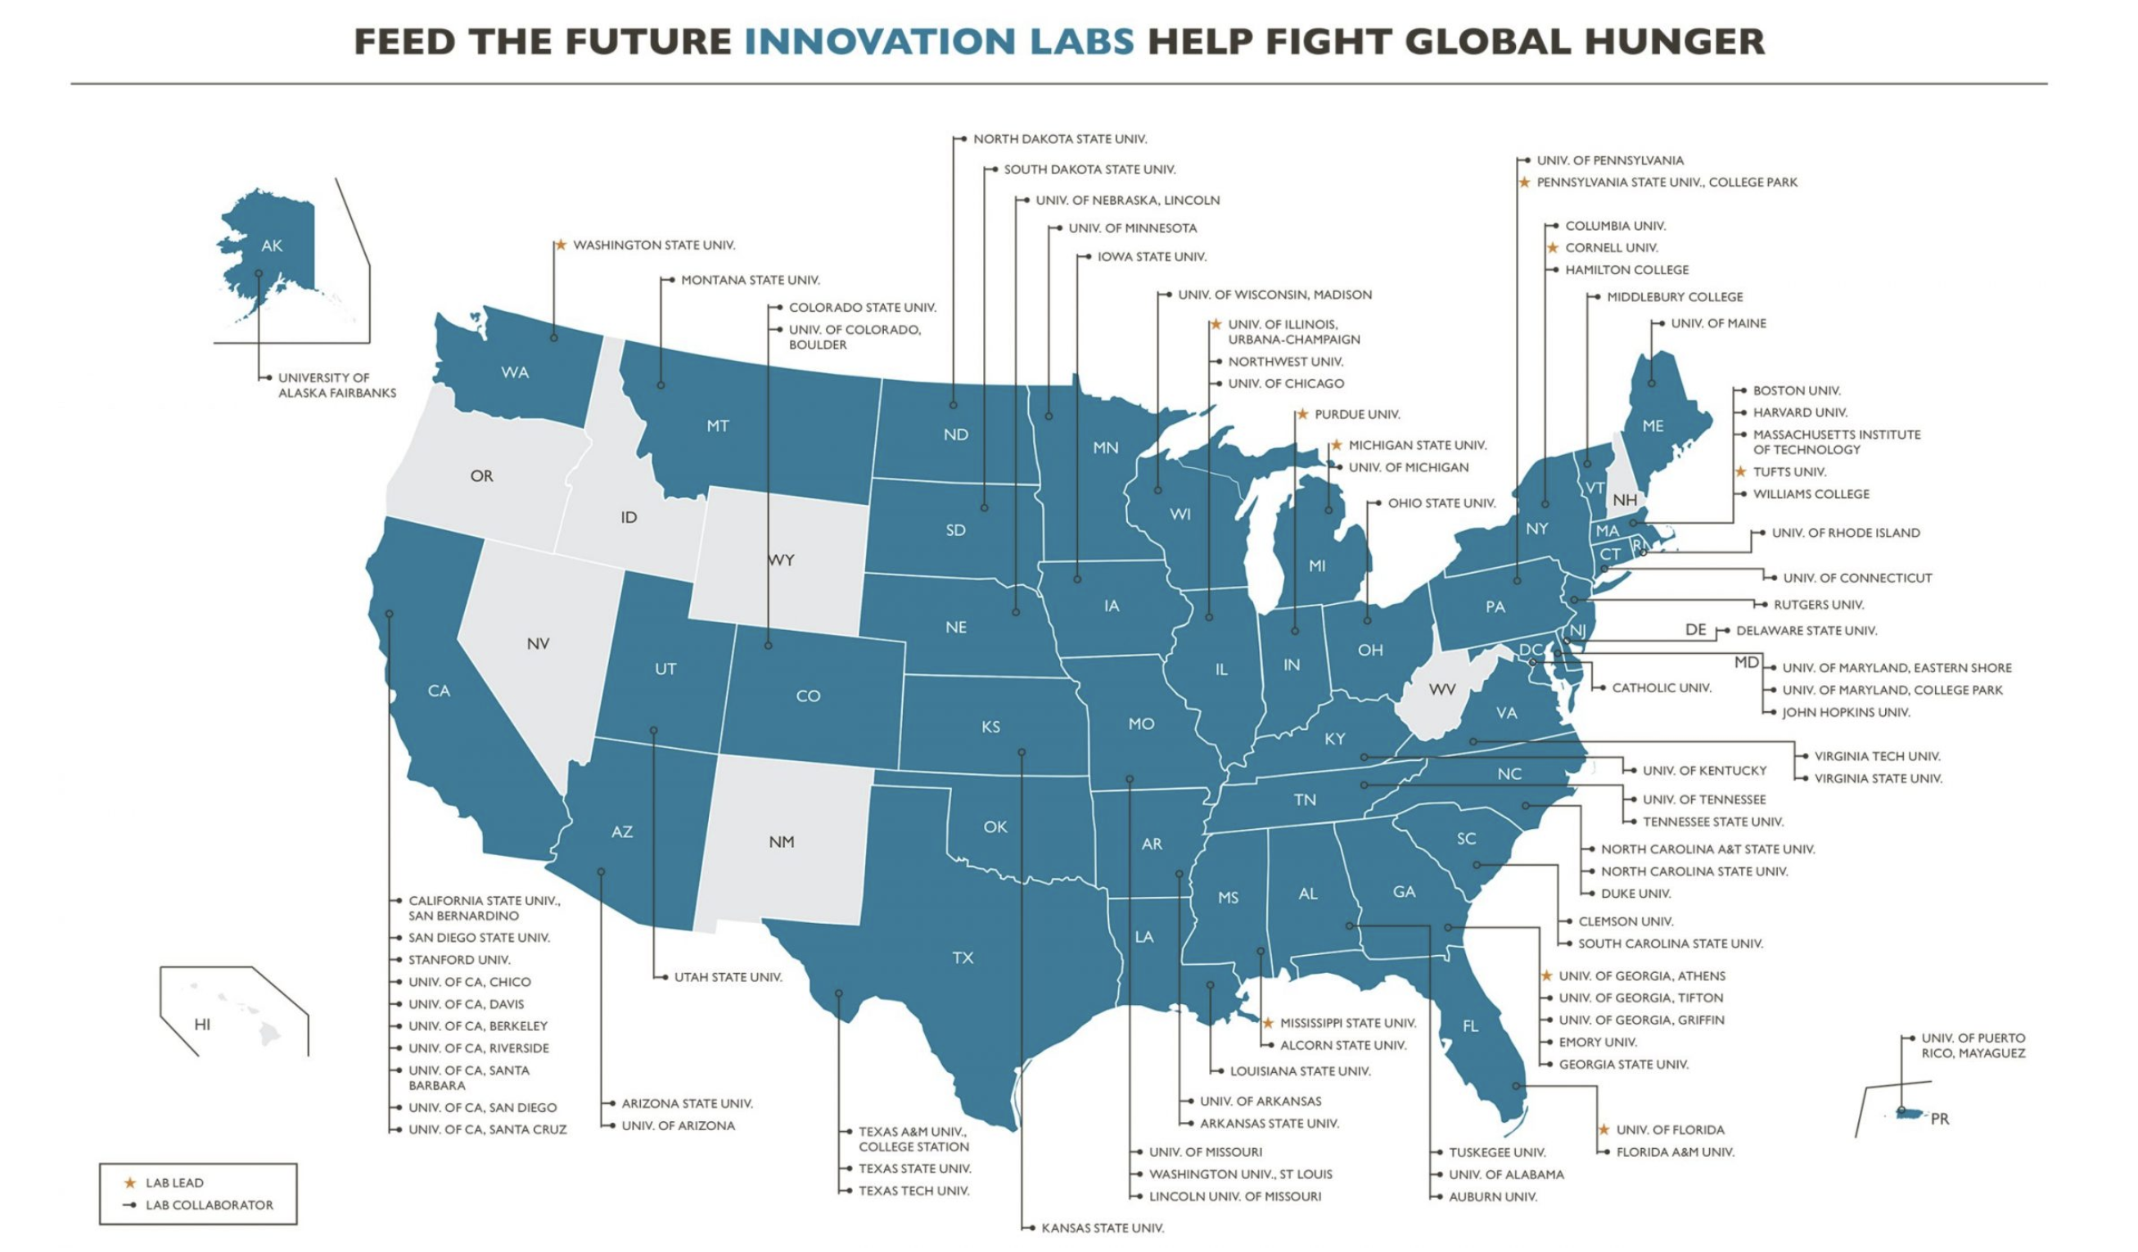
Feed the Future Innovation Labs
The Feed the Future Innovation Labs draw on the expertise of top U.S. universities and developing country research institutions to tackle some of the world’s greatest challenges in agriculture and food security.
Led by U.S. universities, these Innovation Labs are central to advancing novel solutions that support our goals to reduce global hunger, poverty and undernutrition.
Visit feedthefuture.gov/feed-the-future-innovation-labs/ to learn more.
Notes:
Feed the Future Innovation Lab (also known as Horticulture Innovation Lab) is 1 of over 20 Feed the Future Innovation Labs. For information on the other Innovation Labs led by research universities across the United States, visit the url, feedthefuture.gov/feed-the-future-innovation-labs/.

Slide 13
Feed the Future Innovation Lab for Horticulture
“Our global research network works with and promotes local leadership to advance horticulture and social innovations, empowering small-scale producers to earn more income while better nourishing their communities.”
Funded by the U.S. Agency for International Development as part of the Feed the Future initiative and led by the University of California, Davis.
Notes:
In “italicized quotations” is essentially our brand statement - or mission statement. The “funded by” acknowledgement is not the official formal disclaimer language, only there to serve as an example of how to say or refer to Horticulture Innovation Lab – rather informally

Slide 14
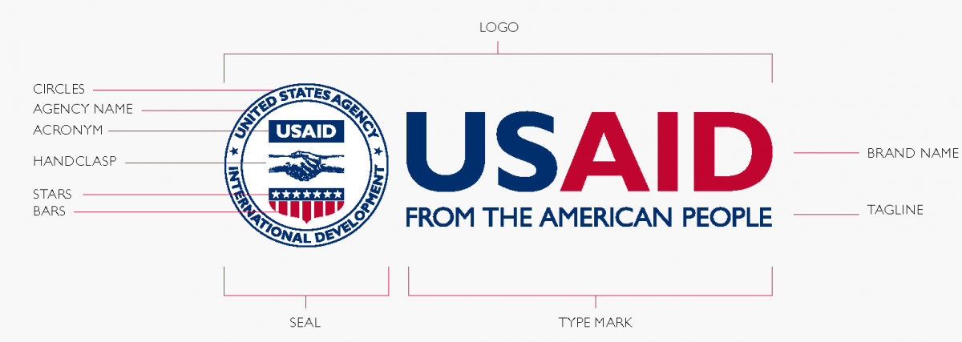
Brand guides and resources
Click on the following links to learn more about the branding guidelines we must all follow:
USAID
usaid.gov/branding
Feed the Future
feedthefuture.gov/branding/
Horticulture Innovation Lab
horticulture.ucdavis.edu/branding-communications
All must adhere to these USAID / Feed the Future branding guidelines.
Be sure to visit each of the above sites for guidelines and downloadable logos and templates.
When in doubt, reach out – first to your Regional Hub POC(s), who will work with you and be able to determine when it is ready for review by management entity.
USAID’s Branding Policy is mandated by the U.S. Government (see usaid.gov/branding/gsm).
Since Feed the Future is an initiative funded by USAID, Feed the Future branding must follow USAID branding guidelines.
Thus, Feed the Future Innovation Lab for Horticulture – being part of the Feed the Future initiative, receives it’s funding from USAID, and must follow both USAID and Feed the Future branding guidelines.

Slide 15
Properly Logo-Branding Your Project
Branding follows funding
Feed the Future Innovation Lab for Horticulture, also known as the Horticulture Innovation Lab, is considered an ‘Assistant Instrument’ by its funder, USAID, and therefore must follow specific brand guidelines of both USAID and the U.S. Government’s Feed the Future global hunger and food security initiative.
With the research projects being funded by Horticulture Innovation Lab, and regionally guided by Regional Hubs, most of the communication materials PIs/projects will use, will require following these guidelines, with brand logo identities to display in this manner:
  Feed the Future (top left – or top center in certain instances)
  Horticulture Innovation Lab logo – bottom left
  (note: this official USAID-approved 3-logo block incorporates the USAID logo)
  Regional Hub institutional logo – following Horticulture Innovation Lab logo
  PI/research project institution/university logo – following Regional Hub logo
  Project partners’ logos – following PI/research project institution/university logo
Notes:
Feed the Future guidelines: feedthefuture.gov/resource/feed-the-future-graphic-and-naming-standards-manual/

Slide 16

The Fundamentals
Feed the Future logo in the upper left corner
Follow the templates on the Brand & Communications webpage (horticulture.ucdavis.edu/branding-communications), and insert additional logos where necessary.
The Feed the Future logo will be the most prominent logo on any document or communications material. If you need to create your own document, please follow all the guidelines for the Feed the Future on pages 15-17.
The USAID logo must be at least the same size and prominence as other partner logos.
The Feed the Future logo can be larger than the USAID logo.
Note:
Do not create or use your own logo, unless it has been previously approved by Feed the Future Innovation Lab for Horticulture.
Disclaimer language
Horticulture Innovation Lab 3-logo block in the lower left corner – officially approved by USAID for use
Additional partner logos order of contributors reading from left to right

Slide 17

The Fundamentals continued – Sample of PowerPoint presentation closing slide or Video outro
Feed the Future logo
Vertical version of logo must always be at top
No other logos may be larger than Feed the Future
Horticulture Innovation Lab
Logo always lower left
No logo may be larger than USAID logo (other than Feed the Future logo)
Regional Hub logo to the right
Partner logos
Read left to right
Equally spaced and sized
For more guidance visit: horticulture.ucdavis.edu/branding-communications
Notes:
Screenshots from PPTs, anatomy of properly branded slides. Sample of presentation closing slide or Video outro

Slide 18
Your Project Title
(Use Feed the Future brand primary font Gill Sans)
Your Name
Your partner’s logo
Additional project partners’ logo(s)
Notes:
Example of brand logo hierarchy arrangement. Feed the Future guidelines: feedthefuture.gov/resource/feed-the-future-graphic-and-naming-standards-manual/

Slide 19
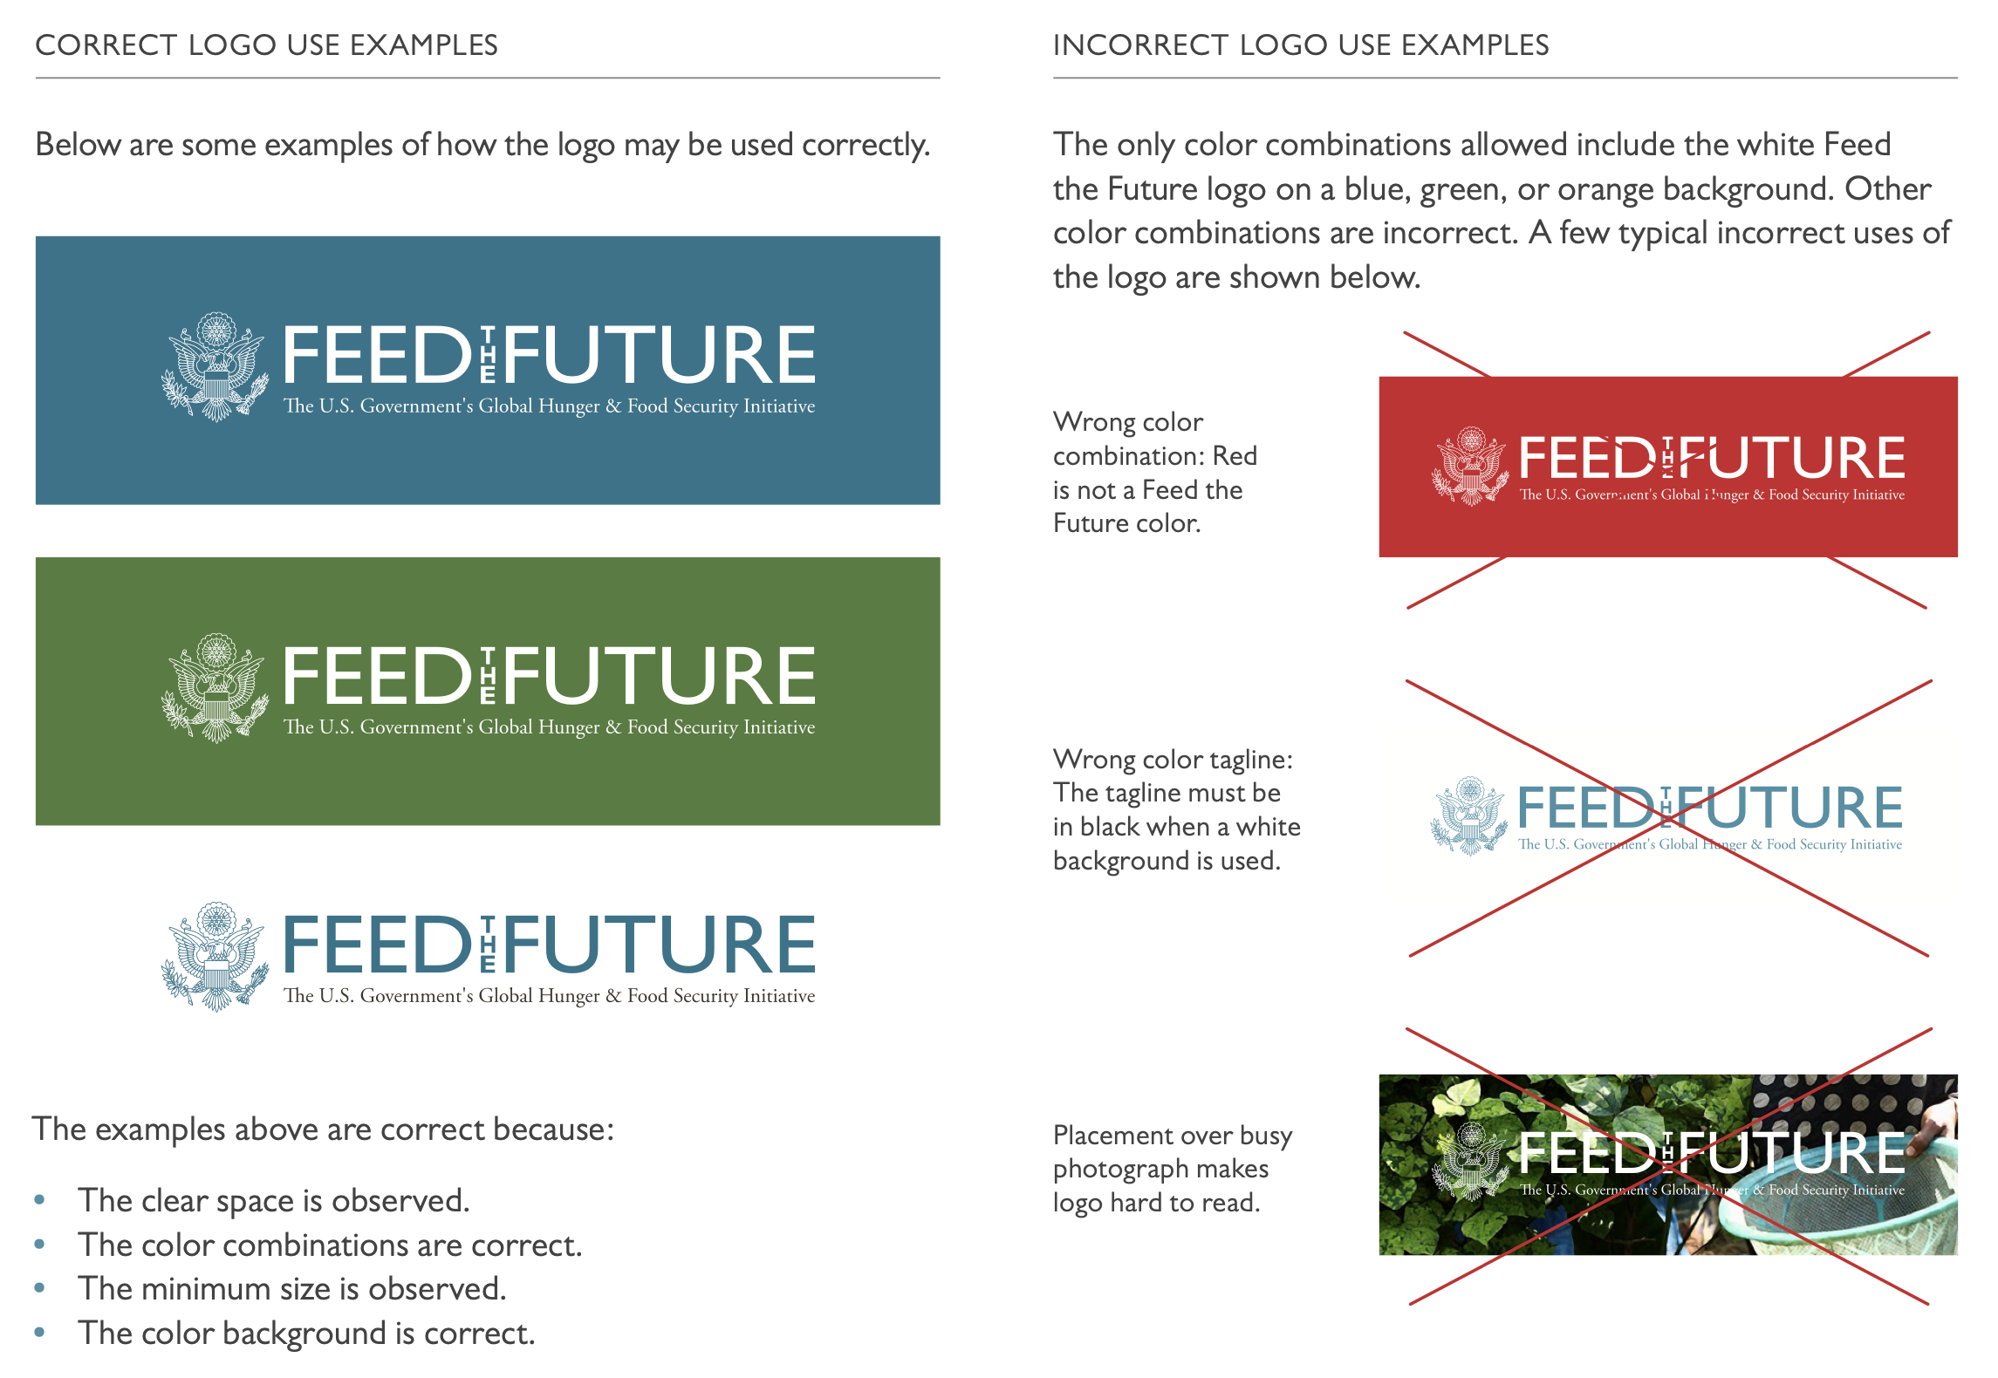
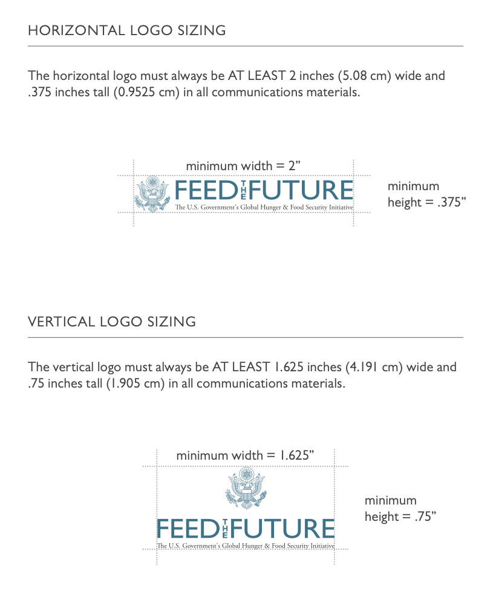
Feed the Future Logo Use & Sizing
Citation: Pages 15, 17 of the Feed the Future Graphic and Naming Standards Manual, available at: feedthefuture.gov/resource/feed-the-future-graphic-and-naming-standards-manual/

Slide 20
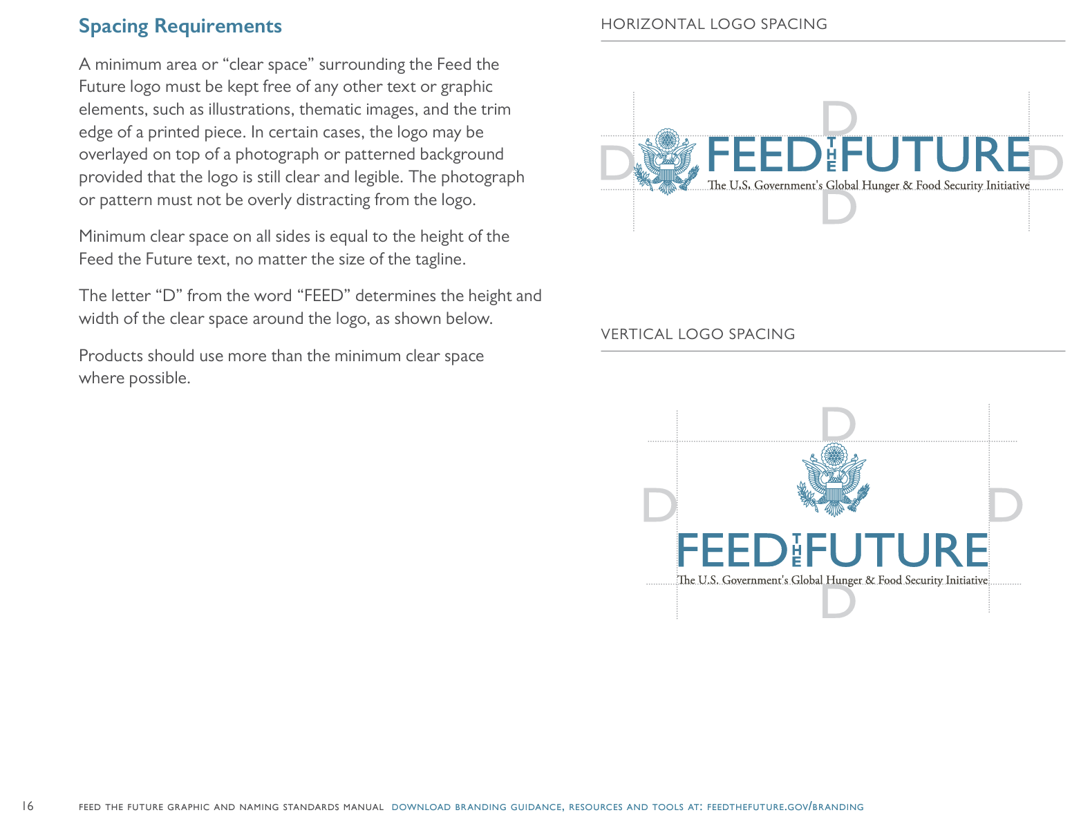
Feed the Future Logo Spacing
Citation: Page 16 of the Feed the Future Graphic and Naming Standards Manual, available at: feedthefuture.gov/resource/feed-the-future-graphic-and-naming-standards-manual/

Slide 21
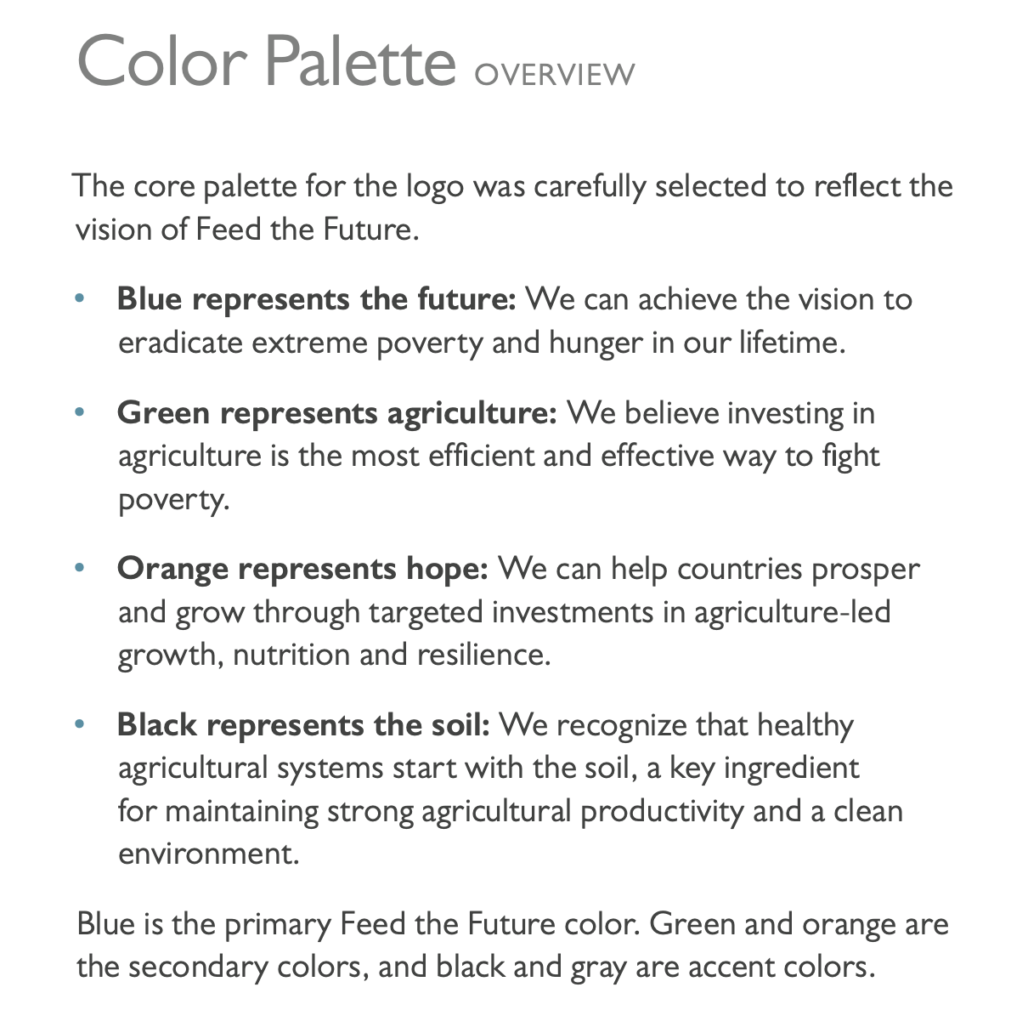
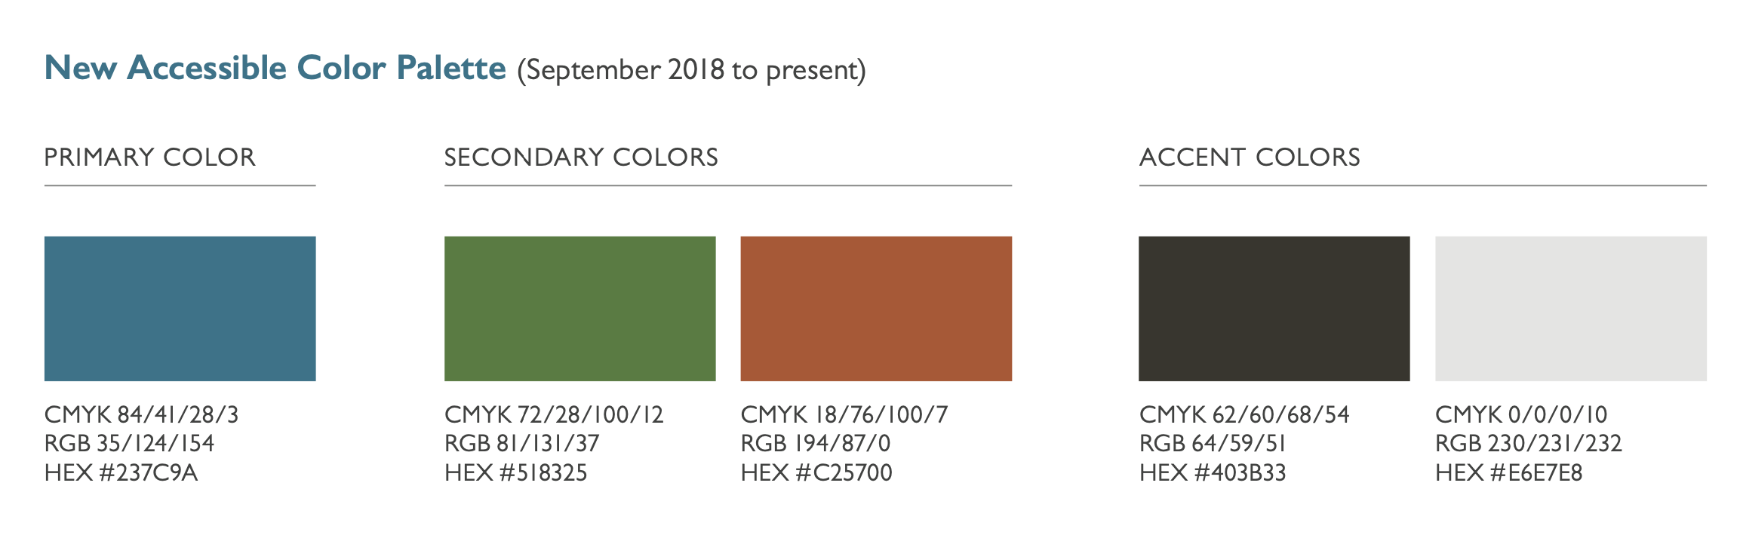
Only use Feed the Future colors
feedthefuture.gov/branding
Refer to pages 18-19 here: feedthefuture.gov/resource/feed-the-future-graphic-and-naming-standards-manual/

Slide 22
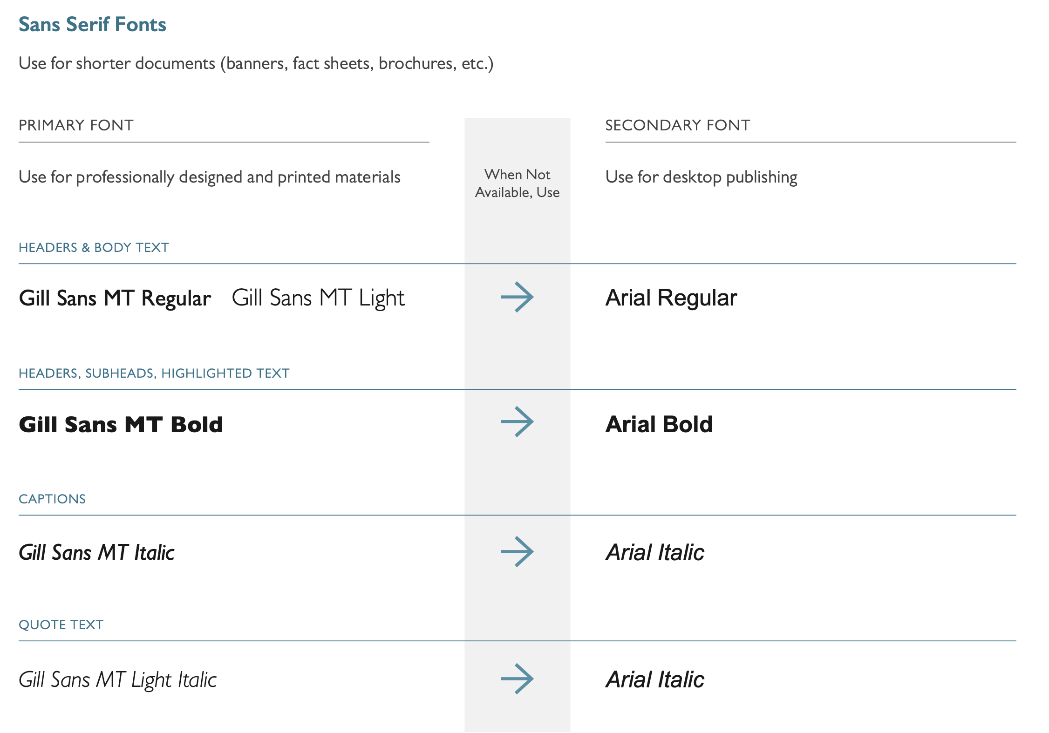
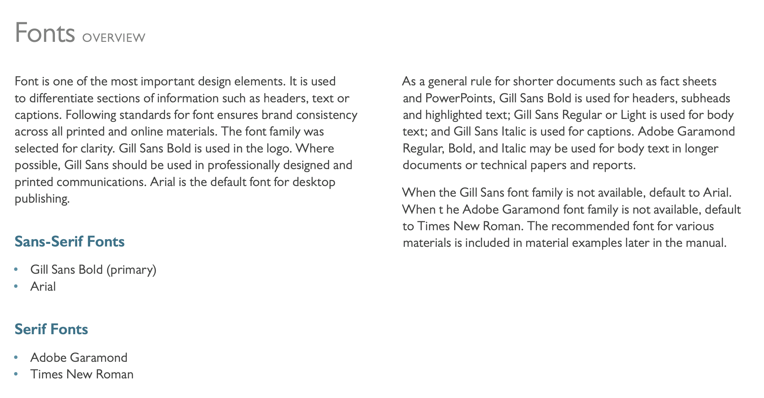
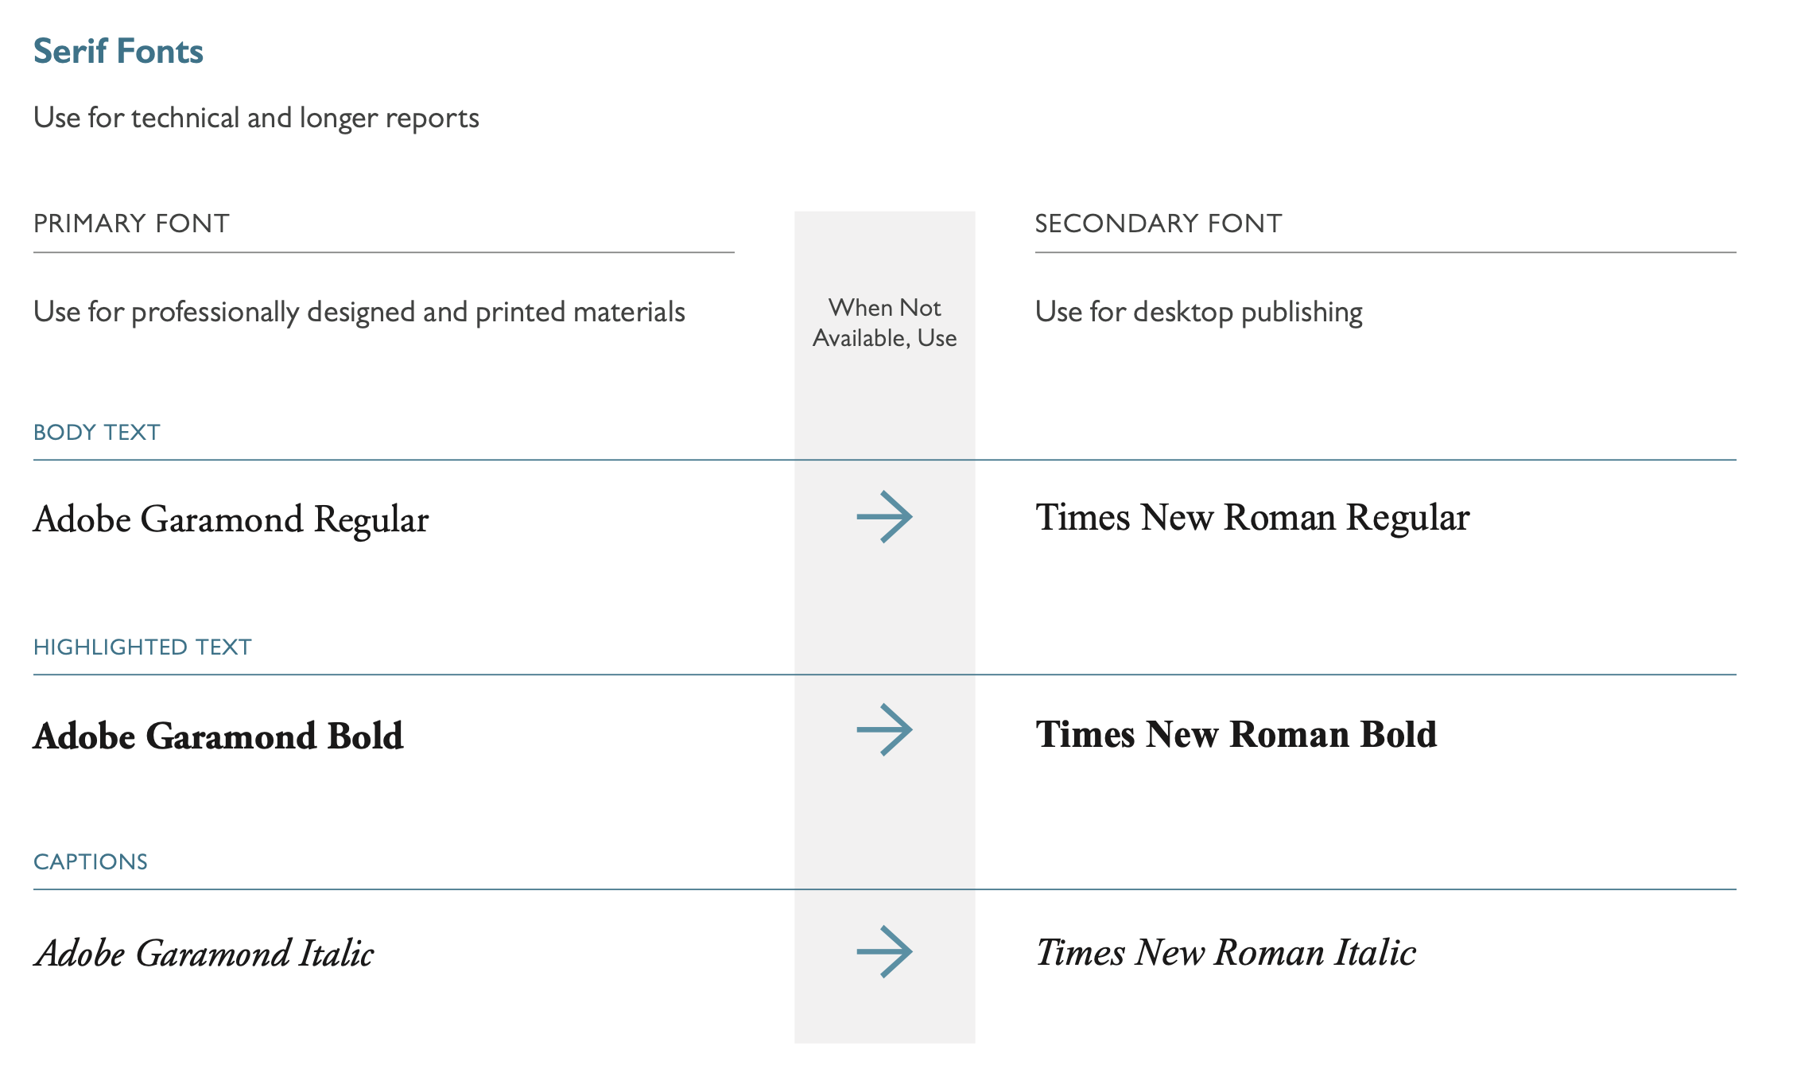
Only use Feed the Future fonts
Refer to pages 20, 22-23 here: feedthefuture.gov/resource/feed-the-future-graphic-and-naming-standards-manual/

Slide 23
Always Include Disclaimer Language
Per USAID-regulations, all USAID-funded public communications must incorporate an appropriate disclaimer to make it clear that the communication is USAID-funded, but does not constitute USAID corporate communications.
Below is an example of disclaimer language to include in your materials:
This program is made possible by the generous support of the American people through the United States Agency for International Development (USAID). The contents are the responsibility of the Feed the Future Innovation Lab for Horticulture, West Africa Regional Hub based at the University of Ghana, and do not necessarily reflect the views of USAID or the U.S. Government.
Citation: Page 42 of the Feed the Future Graphic and Naming Standards Manual, available at: feedthefuture.gov/resource/feed-the-future-graphic-and-naming-standards-manual/

Slide 24
What to Do When Branding Your Materials
  DO use the templates on the Horticulture Innovation Lab website (horticulture.ucdavis.edu/branding-communications)
  DO include your Regional Hub institution/organization logo
  DO add the appropriate disclaimer to all communications materials (including PowerPoints, videos, reports, and websites)
  DO use the approved Feed the Future color palette (pg. 19 of the Feed the Future guidelines)
  Do follow Horticulture Innovation Lab’s approved branding and marking plan
  Do reach out to us with questions!
Feed the Future guidelines: feedthefuture.gov/resource/feed-the-future-graphic-and-naming-standards-manual/
Notes:
Feed the Future guidelines: feedthefuture.gov/resource/feed-the-future-graphic-and-naming-standards-manual/

Slide 25
What Not to Do
  DON’T use an unapproved project logo
  DON’T leave the Horticulture Innovation Lab or Regional Hub logos off communications materials or place either to the right of other partners’ logos
  DON’T abbreviate “Feed the Future” to “FTF”
  DON’T abbreviate “Horticulture Innovation Lab” to “HIL”
  DON’T shorten or abbreviate the Project name
  DON’T include Feed the Future or USAID logos in administrative materials (business cards, email signatures)
  DON’T place other logos next to the Feed the Future logo at the top of the page
FTF
feedthefuture.gov
Notes:
Feed the Future guidelines: feedthefuture.gov/resource/feed-the-future-graphic-and-naming-standards-manual/

Slide 26
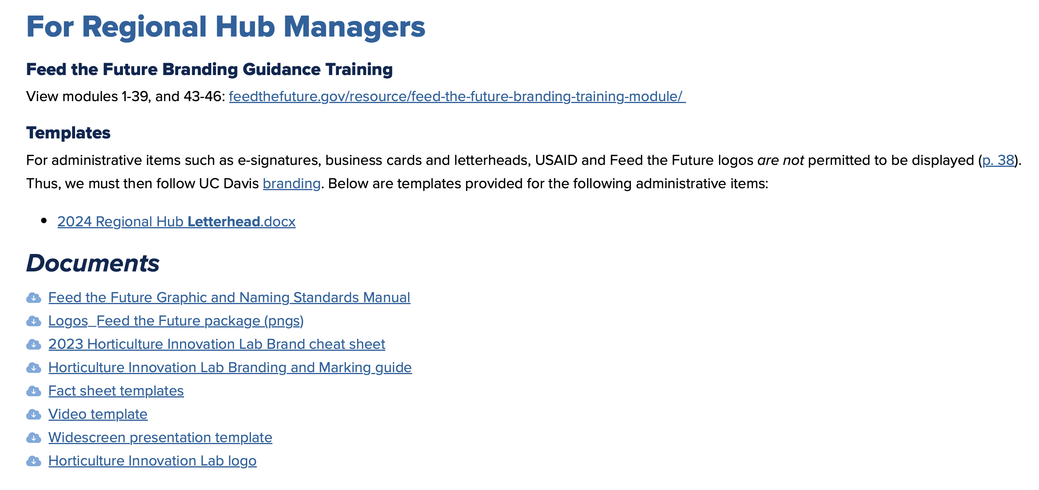
Bookmark this page for guidance and templates
horticulture.ucdavis.edu/communications
From this page, at the very bottom of the page, download the following templates circled in green below:
Notes:
Watch the Online Modules, download the resources

Slide 27
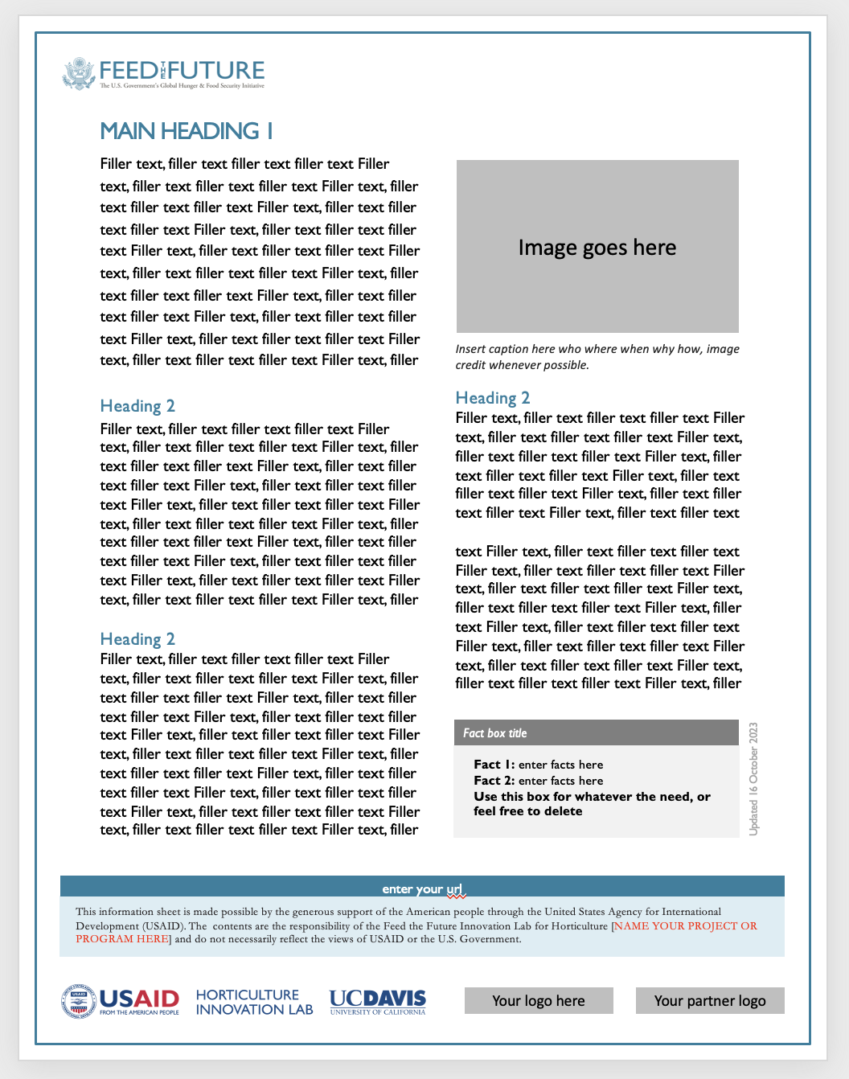
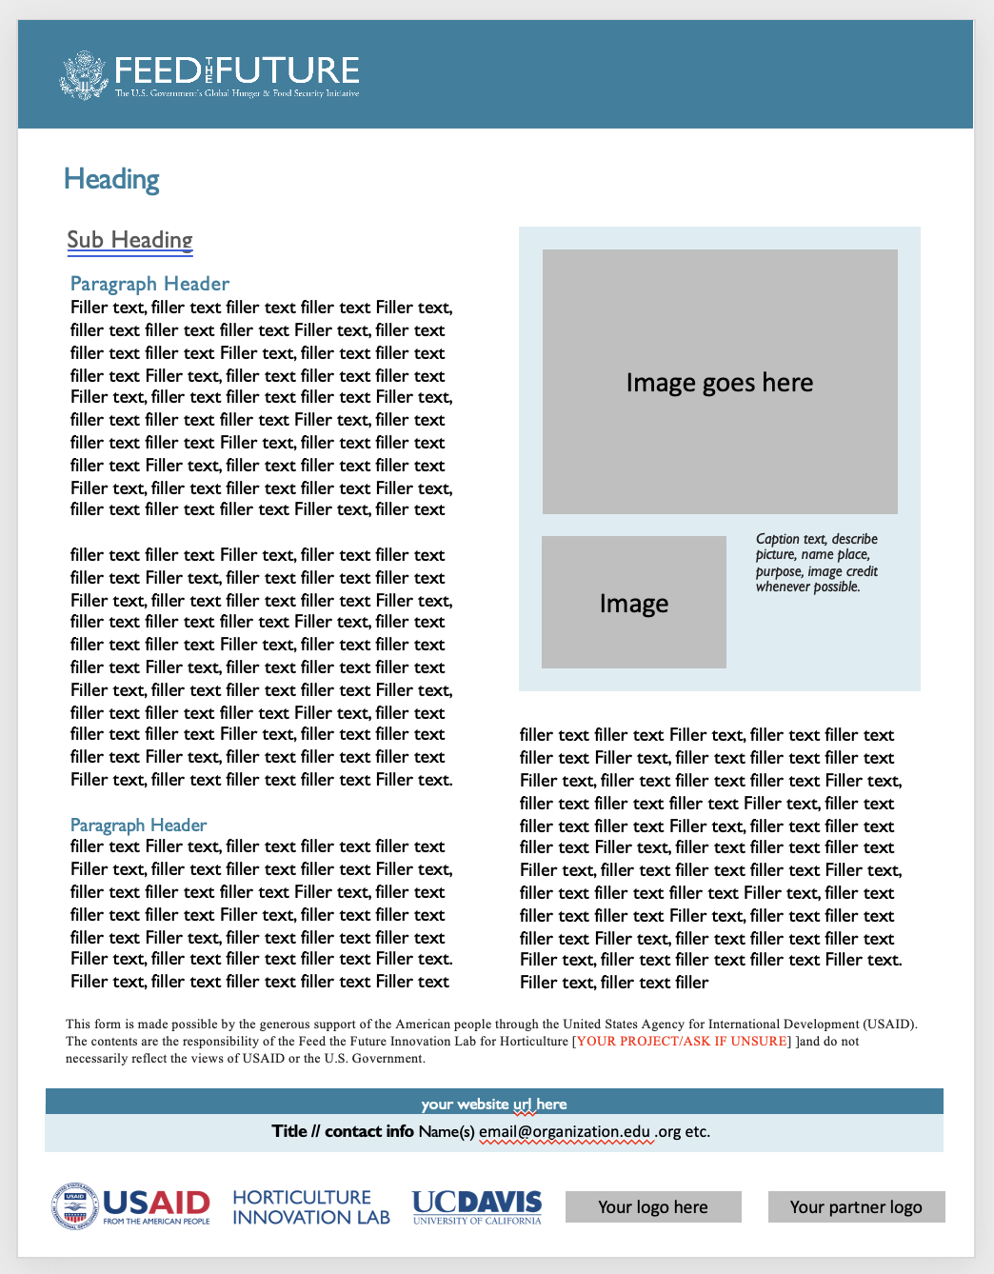

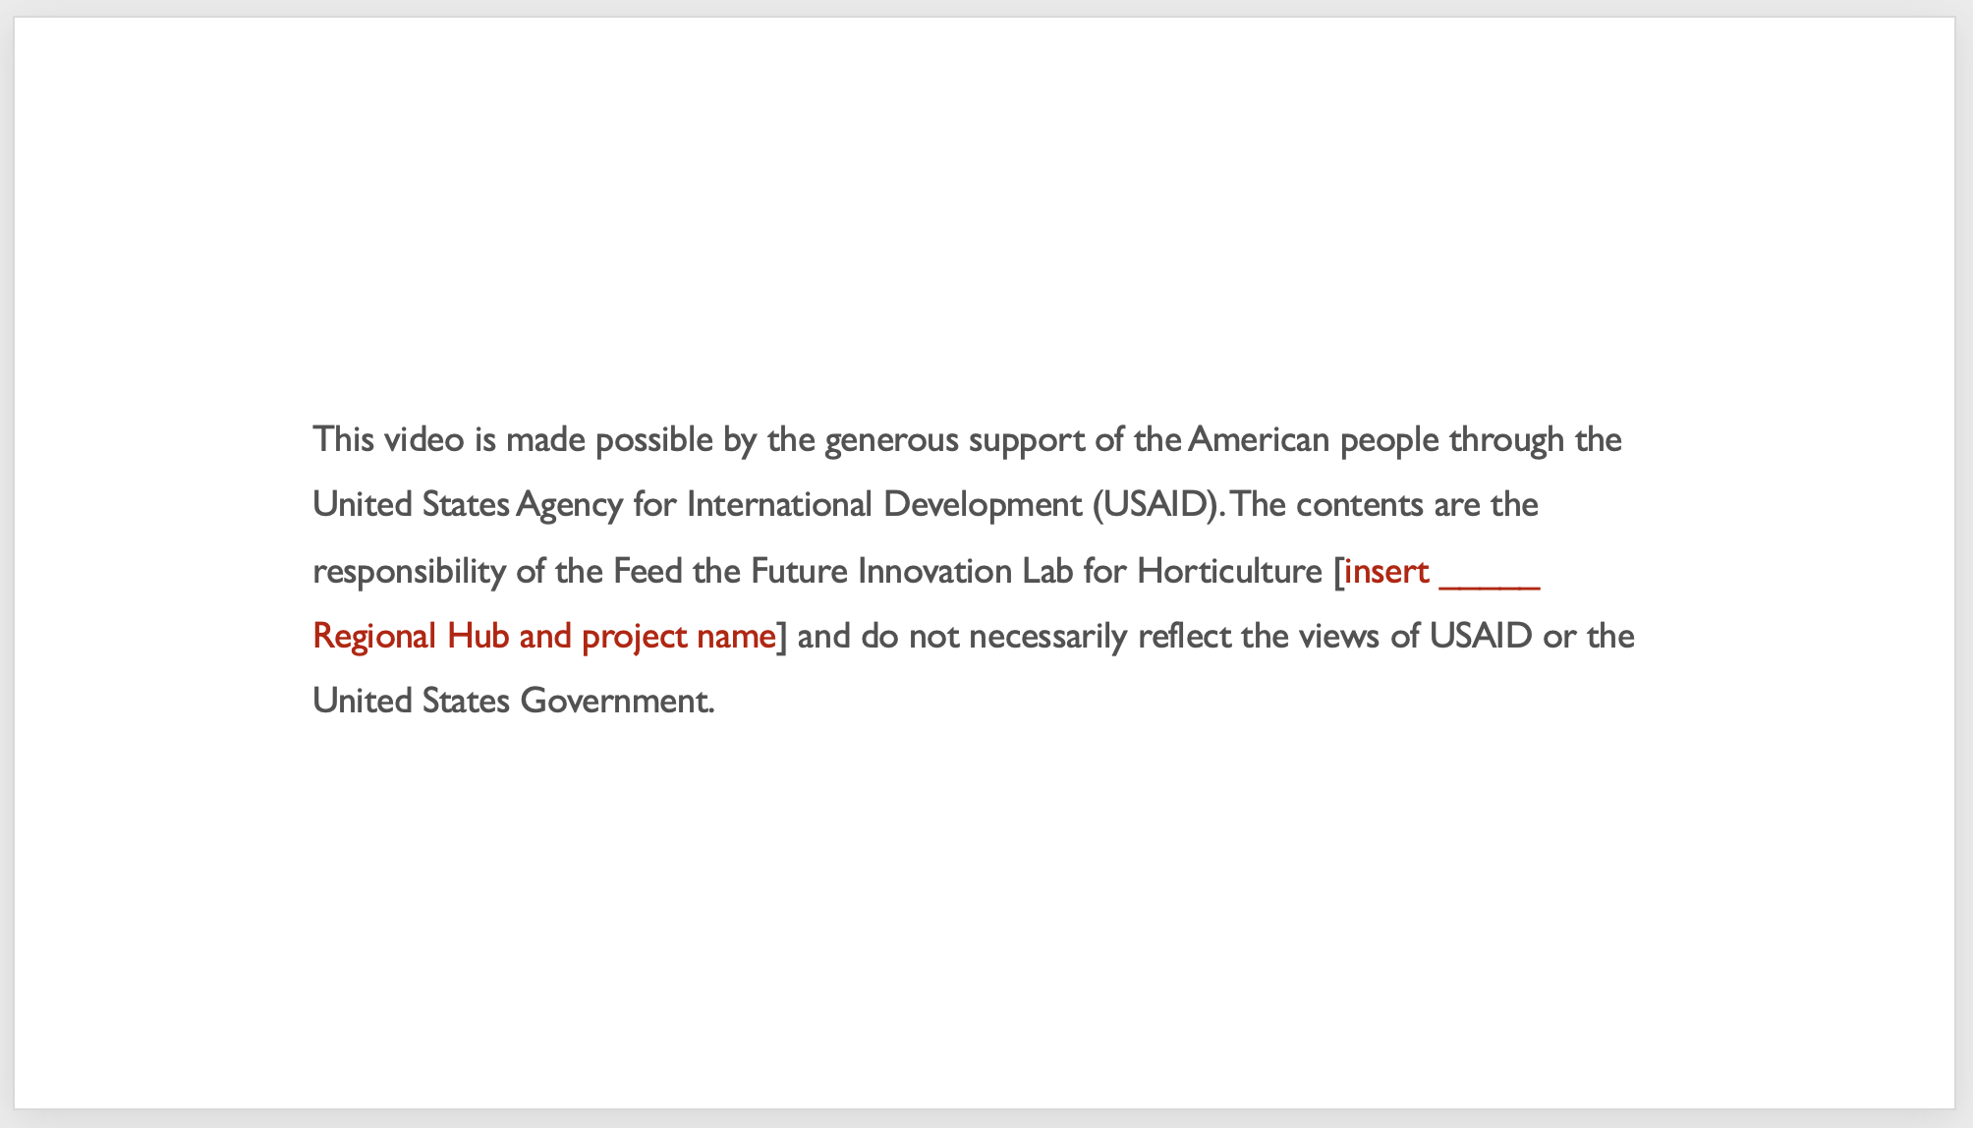

Templates
Downloads available at: horticulture.ucdavis.edu/communications
(below) Fact sheet templates available for you, two options complete with logos that may be adapted to information flyers etc. (just add your logos)!
(below) Video frames
widescreen 16:9 ratio
(right) opening/closing and disclaimer language frames (see pages 42-3, 47 of Feed the Future Graphic and naming Standards Manual).
(above) Fact sheet on left, see p. 40 of Feed the Future Graphic and naming Standards Manual.
feedthefuture.gov/resource/feed-the-future-graphic-and-naming-standards-manual/

Slide 28


Types of Communications
External Communications
Academic
Journal Articles
Other Research
Outreach
Variety of Media
Publications
Media made available to the public;
both academic and non-academic (outreach)
Contact beyond immediate (internal) colleagues
Connections with non-academic audiences unfamiliar with your work
Use full name: “Feed the Future Innovation Lab for Horticulture,” followed by short-form
“Horticulture Innovation Lab.”
Don’t use acronyms such as: FTF, HIL, ILH or any combination of the sort
Notes:
Emphasis on external communications and NO acronyms (FTF, HIL, ILH) + way of referring 1) full formal = FEED THE FUTURE Innovation Lab for Horticulture (also known as Horticulture Innovation Lab), 2) thereafter can use shortest name form = Horticulture Innovation Lab

Slide 29



Scholarly Communication
Open access refers to a publishing model for scholarly research that makes information immediately available to readers at no cost. The research is often free to reuse for scholarly purposes.
– MDPI blog.mdpi.com/2023/08/24/usa-open-access/
Publish in Open Access (OA) Journals so the world may benefit
Don’t make your publicly-funded work inaccessible behind a paywall

Slide 30
Approval Process for PI Outreach Communications
Including but not limited to: flyers, blogs, briefs, stories, presentations, videos, signage, conference materials etc.
Steps | Hints
Adhere to branding requirements | Bookmark horticulture.ucdavis.edu/communications Download a template and develop draft within the template
Submit draft to your Regional Hub point-of-contact (POC) for initial review | POC will work with PI to meet brand requirements, PI will make edits as requested, until meets POC approval. Note: POC requires 1-week response time
Once POC approves, POC sends item as PDF to UC Davis management entity (ME) for final review and approval. Once ME approves, PI may proceed to produce material | ME requires 1-week response time. Note: Depending on whether Feed the Future must be consulted, some requests may take over 1 week to be approved. In some cases it has even taken months – so please plan ahead and take these factors into consideration when building out your production timeline!
Don’t forget to follow the guidelines above, and don’t go into production without first consulting your Regional Hub point-of-contact (POC). Whenever in doubt, reach out!

Slide 31
Digital Communication,
Multimedia, and Storytelling

Slide 32
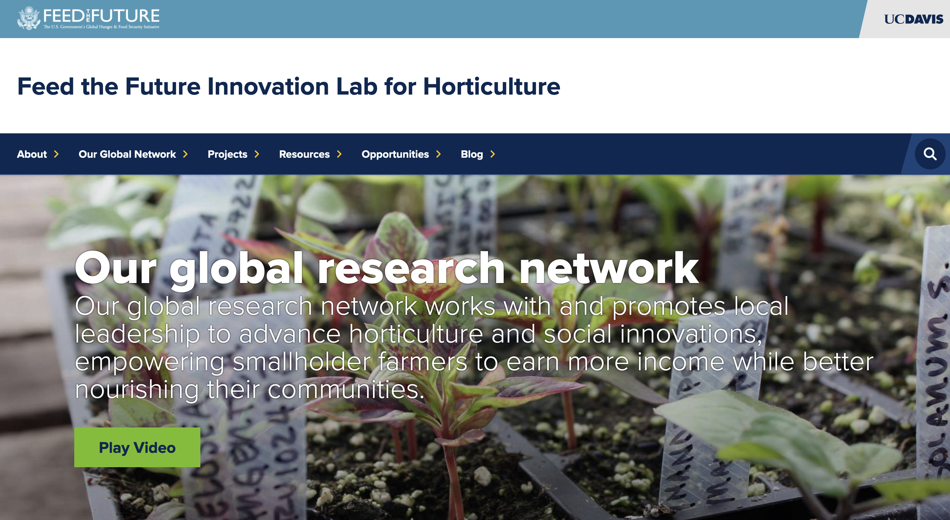
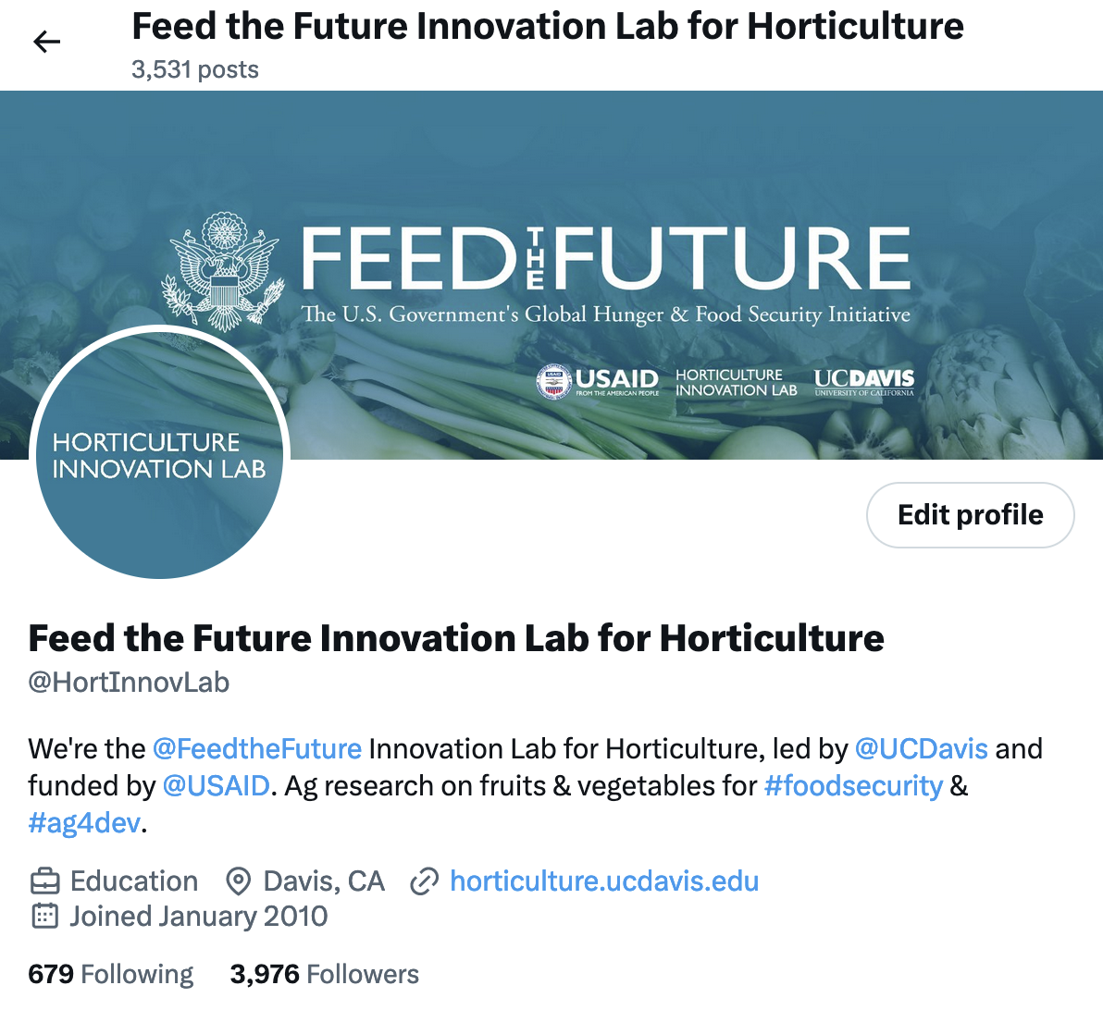
Join us online @tag us on social!
Build your personal brand, self-promote
Wear your institution/university’s swag in photos.
Make sure to include hyperlinks in web blogs and @tag us (and relevant partners) in social – to highlight the collaborative nature and global impact of your research efforts!
Be inclusive and engage audiences with updates, stories, photos, short-form videos etc. across any and all platforms – all following proper brand guidelines of course. Whenever in doubt, reach out to us for guidance.
SOCIAL MEDIA ACCOUNTS
X twitter.com/HortInnovLab
Linkedin linkedin.com/company/hortinnovlab
Facebook facebook.com/ilabforhort
Instagram instagram.com/hortinnovlab
YouTube youtube.com/@hortcrsp
TikTok tiktok.com/@hortinnovlab
Flickr flickr.com/photos/hortcrsp
WEBSITES
Main site horticulture.ucdavis.edu
Agrilinks agrilinks.org/activities/horticulture-innovation-lab
GenderUp genderup.ucdavis.edu
Notes:
Social Media and Web presence of Horticulture Innovation Lab for them to access, know, study and engage with

Slide 33
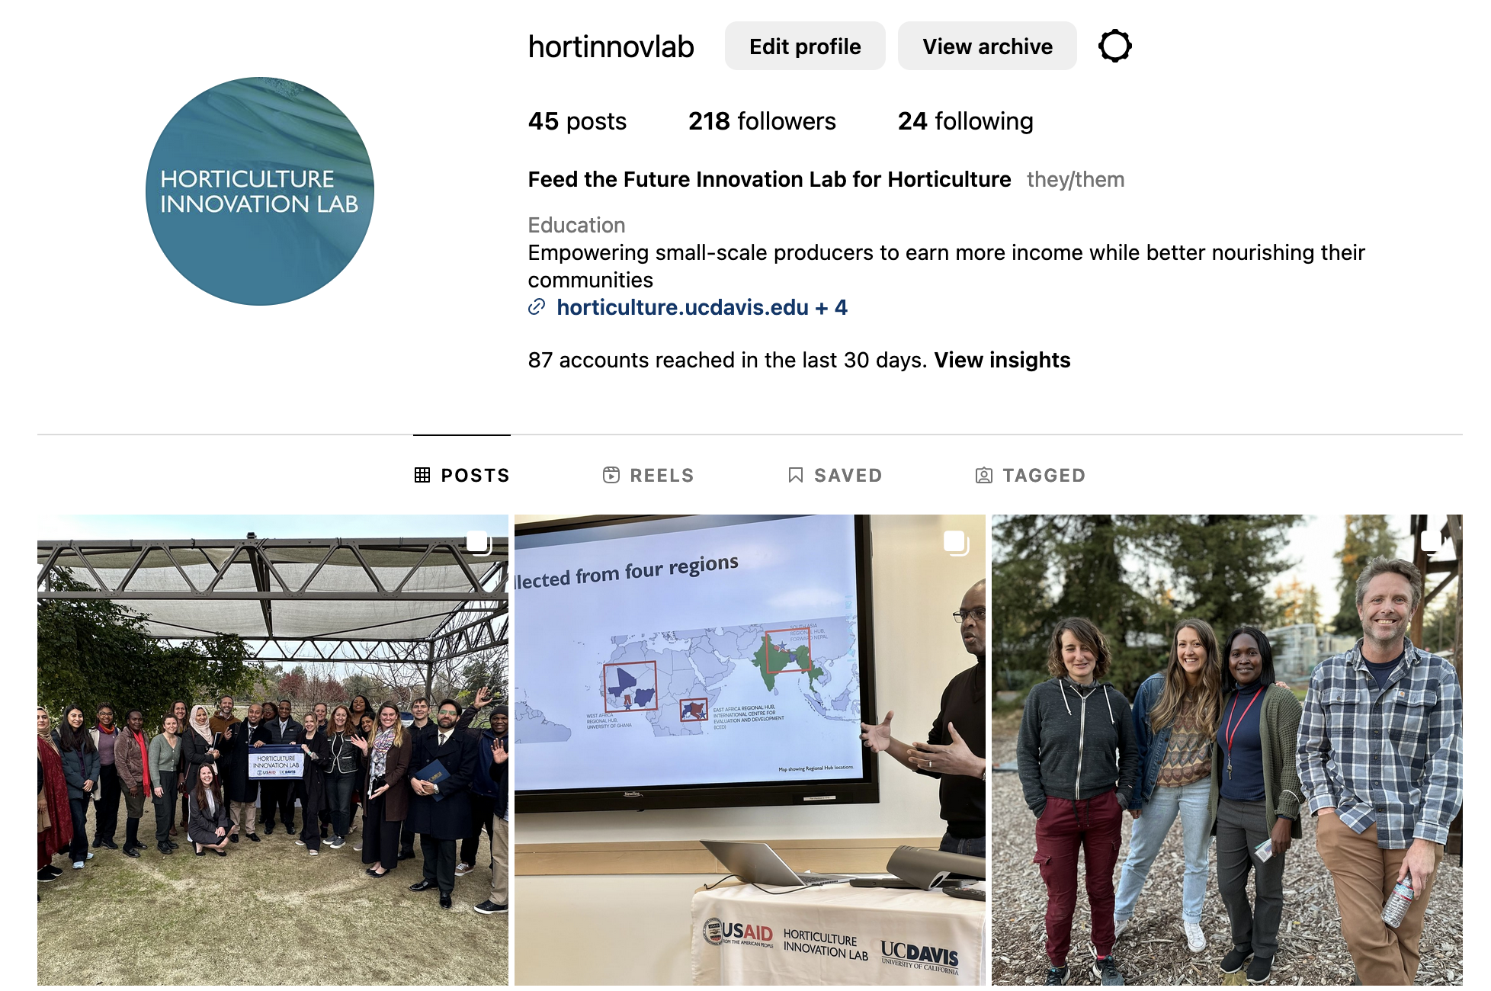
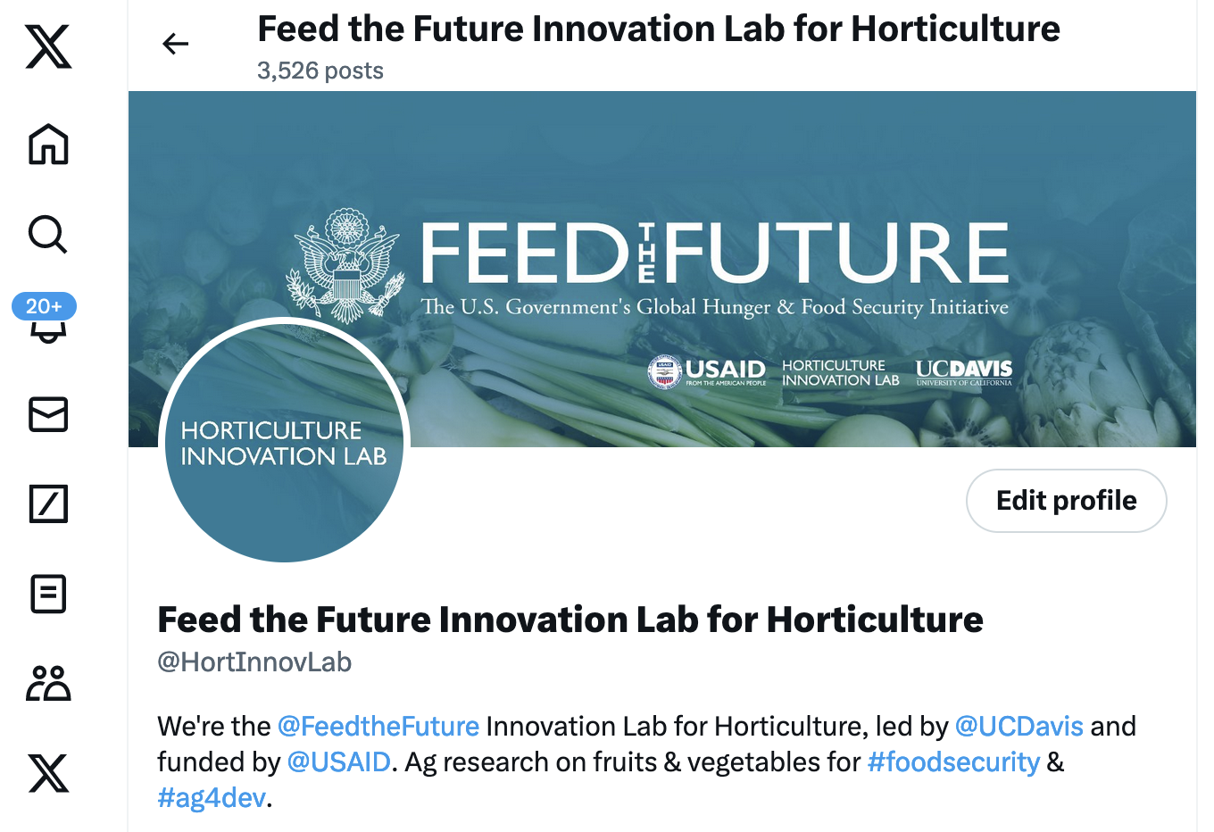

Engaging with and Speaking to the Digital Community
Diversity, Equity & Inclusion in Social Media
Acknowledge and give digital community members a voice and opportunity to engage. Visually communicate inclusivity through imagery, @tag and apply #hashtags that emphasize community impact, relating to the larger conversation and global discussion.

Slide 34
Storytelling
Whether you’re writing/audio-visualizing a journalistic piece, short- or long-form video, podcast, story blog, or captioning an awesome graphic/photo for a social media post, always address the 5 W’s – Who | What | When | Where | Why
Follow Editorial Guidelines for USAID Newsletter stories
Feed the Future Agrilinks Editorial Style guidelines here: agrilinks.org/agrilinks-editorial-style-guide
Note their photo/video documentation requirements, as you take images throughout your research journey
Always get someone’s permission to document or record them (verbal and/or ideally signed consent form)
Ask full names for more personalized captions and provide engaging information of what is happening

Slide 35
Writing for Impact - Before
With the Ukraine Supplemental Funding, USAID was able to build on foundational investments and rapidly deploy climate resilient seeds and agricultural inputs using its network of agricultural financing. USAID expanded its input loan program from 50,000 to more than 100,000 households in 19 districts. By targeting these households with the input loan program, USAID is not only mitigating the current crises, but also providing a pathway toward greater food security. For farmers like Fatinesi Beliyamu, the input loan program is the first step toward treating farming as a business. With the certified soybean seed and inoculant that USAID provided, Fatinesi expects to more than double the quantity of soybean that she harvests this year. With the proceeds, she plans to purchase certified soybean and maize seed next year, and also invest in a bicycle and cart so she can aggregate produce from her neighbors, and transport it to larger markets where she can sell it for a higher profit.

Slide 36
Writing for Impact - After
Market shocks and supply chain disruptions over the past year have made life particularly difficult for smallholder farmers in Malawi. Farmers like Fatinesi Beliyamu have struggled to afford high-quality inputs like fertilizer and certified seed critical for growing enough soybean and maize to feed herself and sell for income. She was able to obtain these items by participating in an input loan program bolstered through $12 million in USAID supplemental funding. Fatinesi is one of more than 100,000 Malawians across 19 districts who have benefited from this program, which works by adapting existing village savings and loan groups so members can buy essential farming inputs. The farmers then repay the cost of the inputs plus ten percent interest into a revolving fund after they harvest and sell their produce. Fatinesi expects to more than double her previous harvest and plans to use her profits to purchase a bike and cart to bring together produce in her community and sell it at more profitable markets closer to town. (This impact example provided the basis for a more in-depth human interest story: Fatinesi's Future: Farmers Boost Incomes and Expand Food Production in Malawi)

Slide 37
Written and Visual
Communication

Slide 38
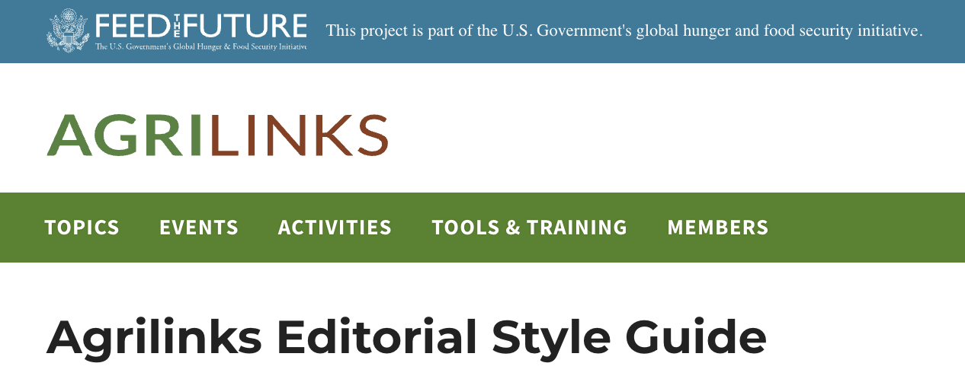
Editorial Style Guidelines
Always follow the Feed the Future Agrilinks
Editorial Style Guide: Agrilinks.org/agrilinks-editorial-style-guide
              A guide to follow for writing and photography!
Agrilinks is Feed the Future’s platform for technical knowledge exchange on agriculture and food security development topics. We welcome content submissions from the food security community and are committed to getting our members’ blog posts and events ready for publishing. This editorial style guide is based on the AP style guide, the U.S. government’s 18F office and plain language guidelines.
All submissions will be reviewed for quality and alignment with the guidelines below. Accepted submissions will be added to Agrilinks’ editorial calendar and published accordingly. Submissions that do not meet Agrilinks’ needs or quality standards will not be published.
Note requirements for photo:
credits, descriptions, quality, file naming, alt tags – are the same as what is being requested in the Piestar system.

Slide 39
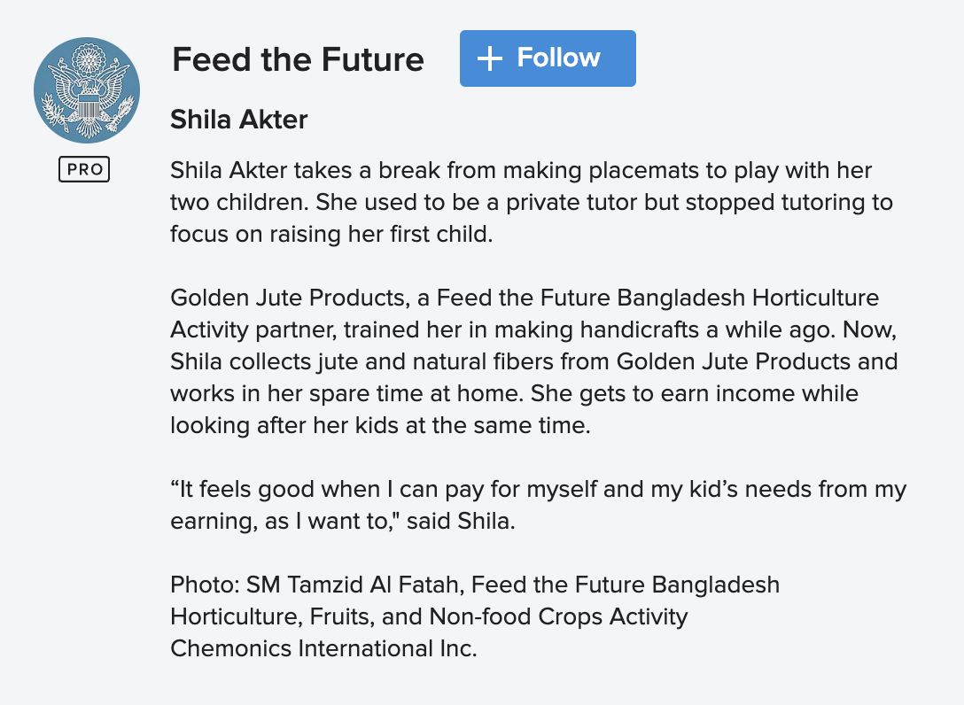
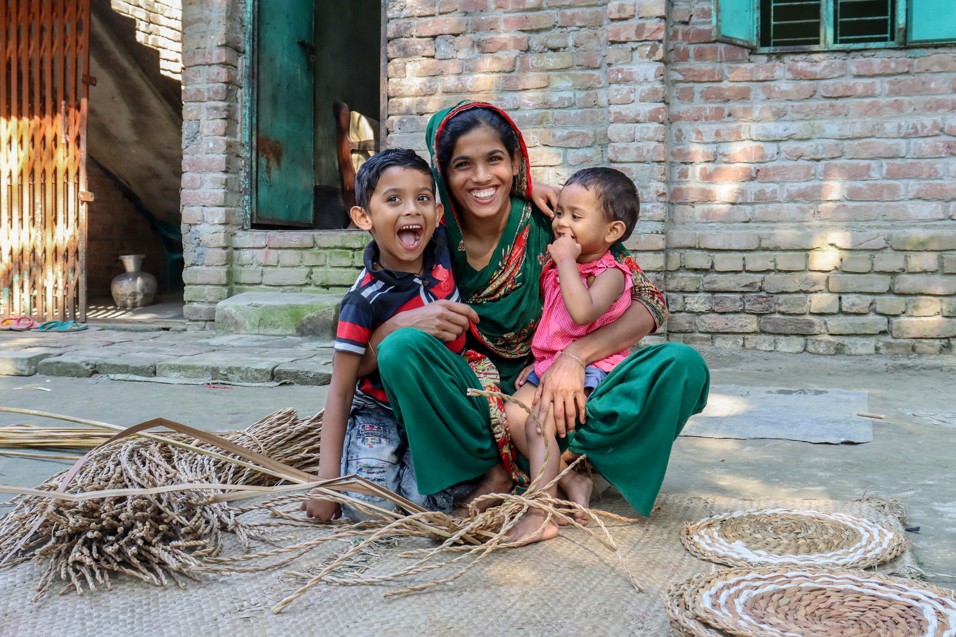
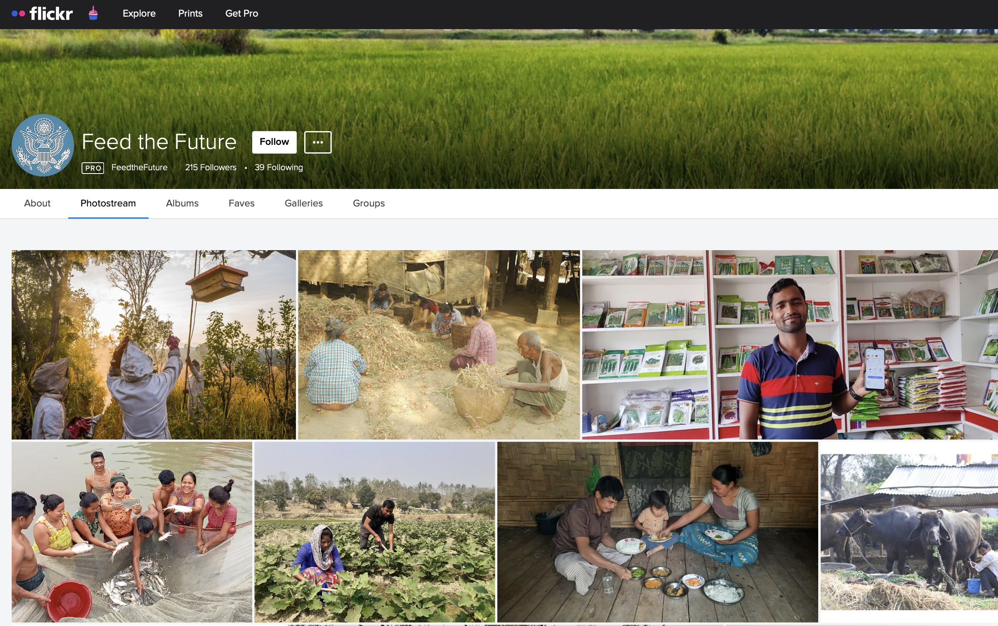
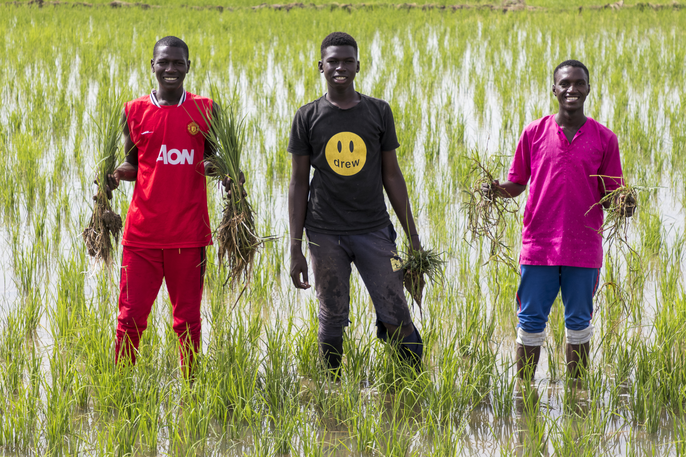
What Feed the Future looks for in photos and visual storytelling
For examples of what Feed the Future looks for in terms of composition, storytelling, captioning and photo-crediting, browse the Feed the Future Flickr Collection Flickr.com/photos/feedthefuture/.
flickr.com/photos/feedthefuture/52740607722/

Slide 40
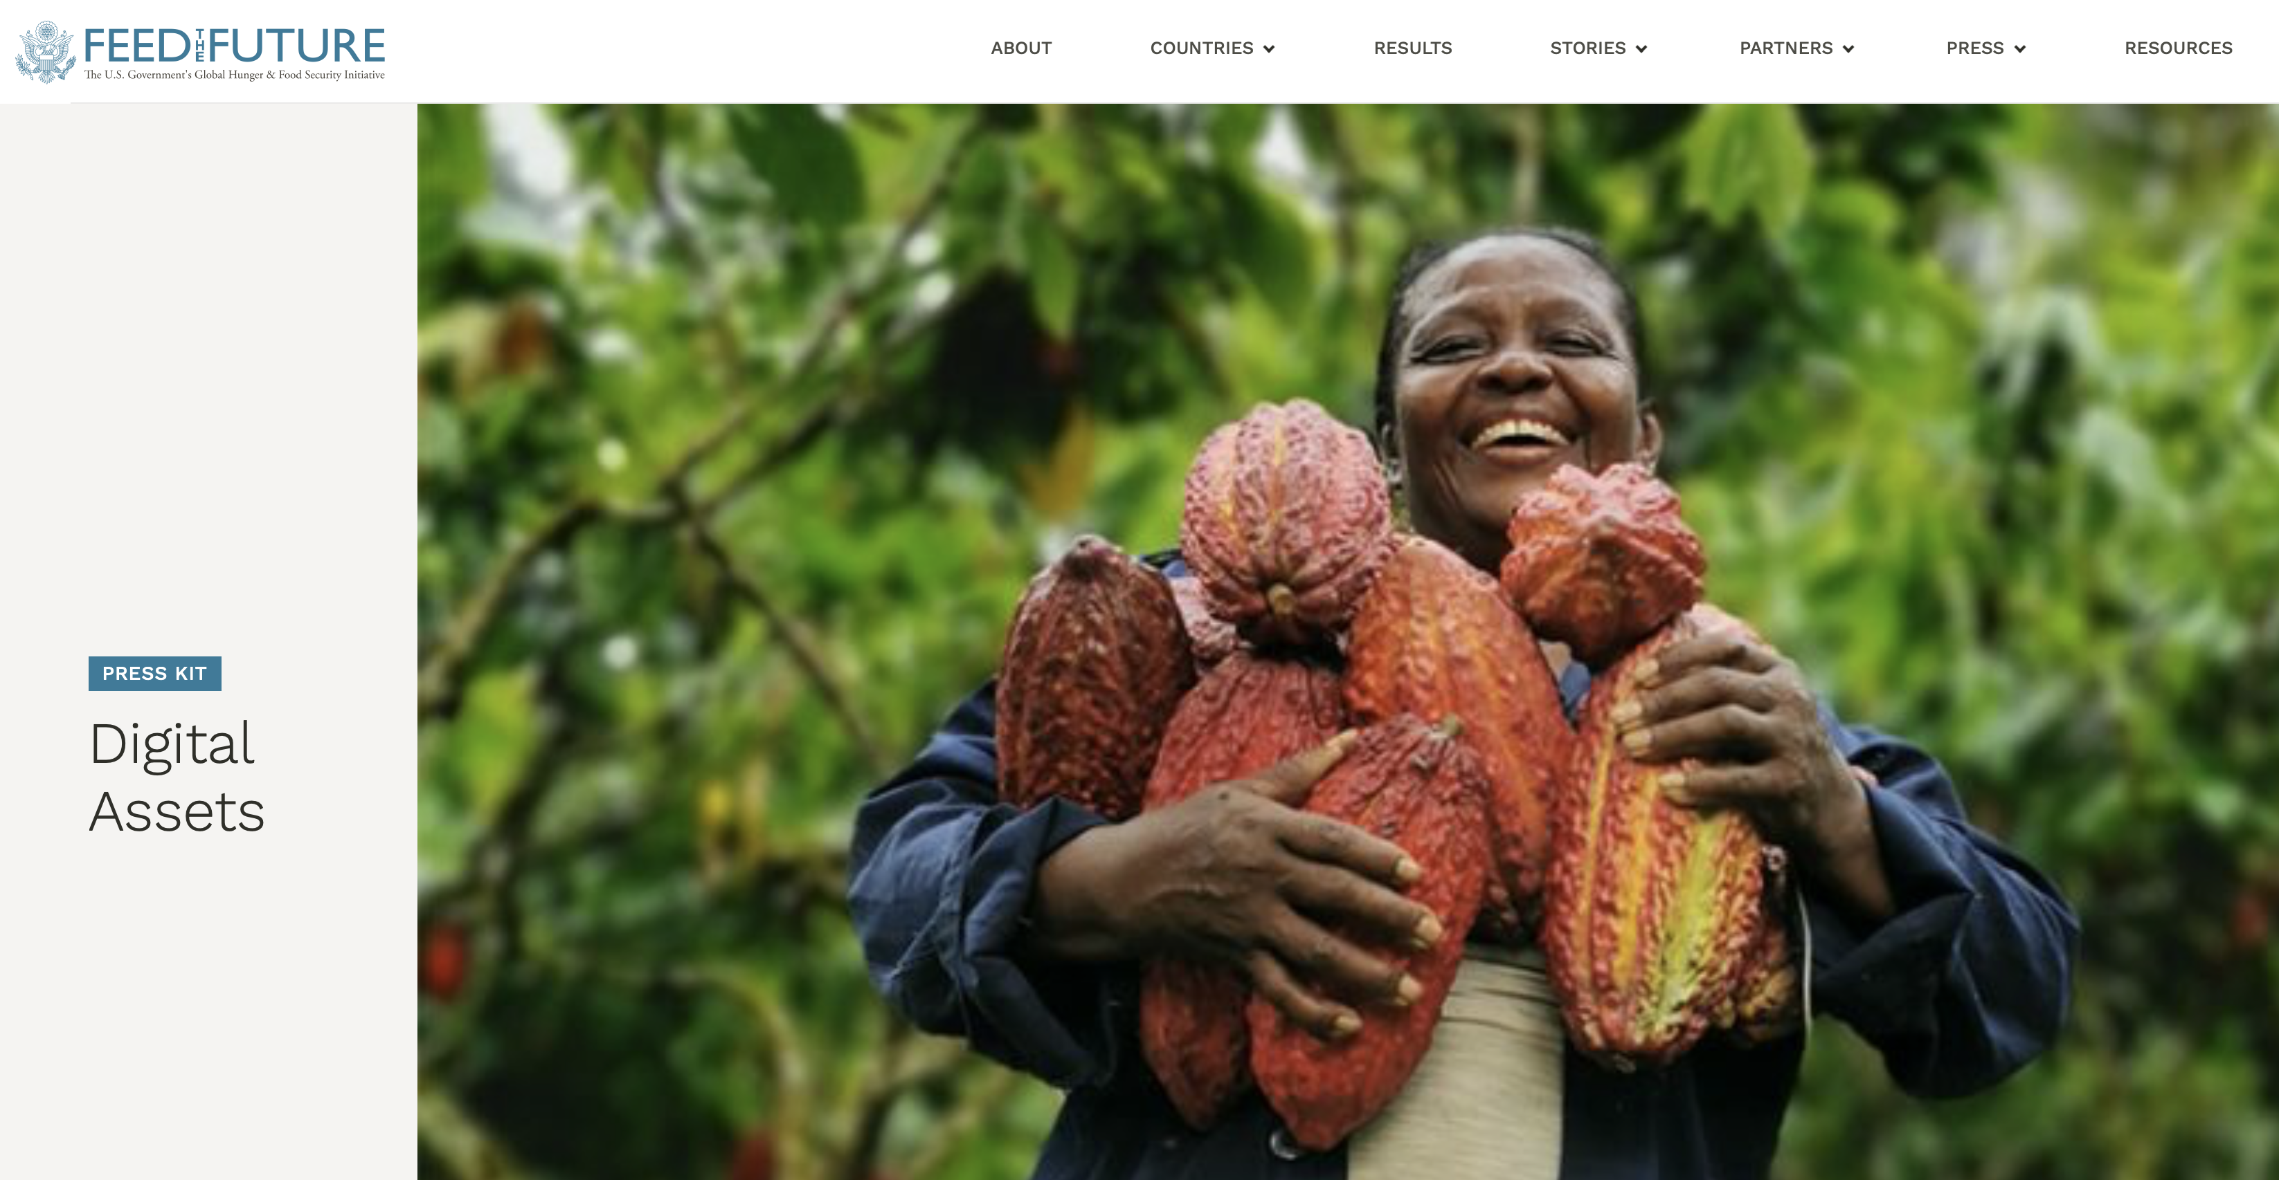
Additional Resources | USAID and Feed the Future guidelines and tips
For guidelines and tips on capturing visual content visit USAID.gov/branding/photo-guide-usaid-partners
For examples of Feed the Future Digital and Brand assets, Photography and Social Media content visit FeedtheFuture.gov/press-kit/digital-assets/
Ethical NGO Storytelling: Aligning Values and Visuals
Important, gut-wrenching situations exist all around the world, and we all want to shine a light on them – especially those of us whose job it is to shape the visual narratives presented in global media.
But we can get so caught up in the cause that we forget the person.
We can forget that the people in our pictures and videos, illustrations, and artworks have lives beyond our lens. Or we’re under pressure to find an image or clip that “works” – instead of one that is “right.“
      taratw.com/ethical-ngo-storytelling-aligning-values-and-visuals/

Slide 41
Inclusive Communication | Language, Audience Receptiveness and Triggers
Word choice. What’s in a name?
How do we establish terminology and a basis of understanding, without perpetuating negative stereotypes and cultural norms that hurt historically marginalized populations? Take a look below, and assess which words carry any connotations to you:
Are there alternatives to ‘military’ language that we can use to inspire hope and togetherness rather than combativeness?
Do certain words or concepts misrepresent and/or trigger negative responses and desensitize audiences?
Advance
Mobilize
Global North
Colonial
Foreigner
Combat Climate Change
Progress
Evolve
Global South
Indigenous
Native
Nurture sustainable approaches, Embrace Indigenous practices, Acknowledge Holistic Systems Thinking
Aboriginal
Belonging
Colonial
Deconstruct
Decolonize
Developed
Dominant
Diversity
Eastern
Empowered
Equity
Food Insecure
Food Secure
Foreigner
Funder
High-Level
Holistic
Globalize
Global North
Global South
Inclusion
Indigenous
Indigenize
Industrialize
Local
Locally-led
Low-income
In-country
Majority Marginalized
Minority
Native
On-the-ground
Re-Indigenize Regenerative Farming
Recipient
Regions
Sustainable Farming
Undeveloped
Urbanize
Vulnerable
Western
Westernize
vs.

Slide 42
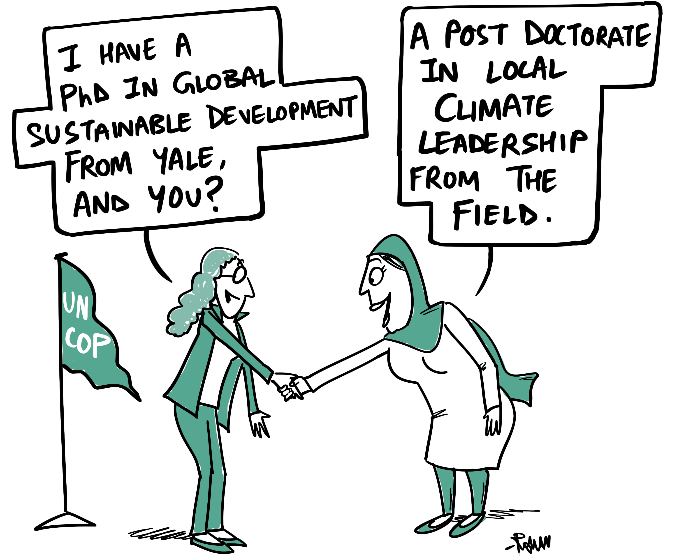
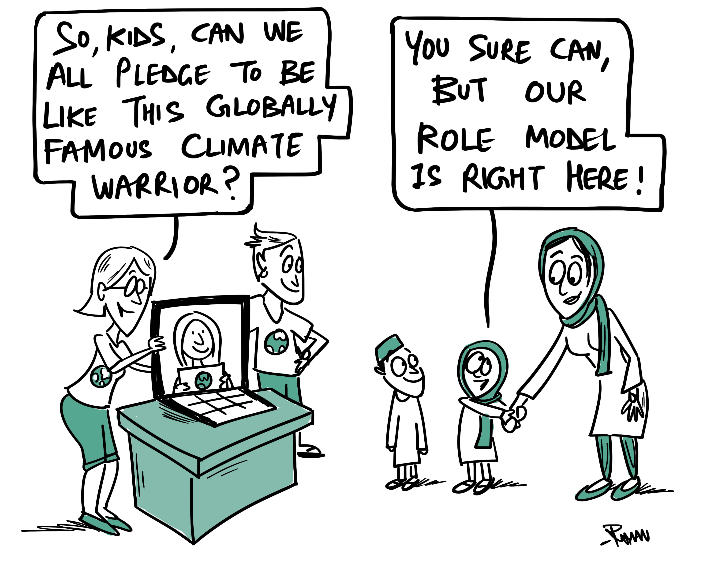
Local Leadership: Empowering Narratives
Dissolve non-inclusivity. Acknowledge and highlight the value of historically marginalized populations, local, and indigenous communities and knowledge systems
Images above featured in Resilience Hub Newsletter 10 December 2023 https://cop-resilience-hub.org/

Slide 43
Case study: At least we fed the hippos!
A Lesson on 2-way Communication
Building bridges and resilient communities
“So we arrived there with Italian seeds in southern Zambia in this absolutely magnificent valley going down to the Zambezi River, and we taught the local people how to grow Italian tomatoes and zucchini… And of course the local people had absolutely no interest in doing that, so we paid them to come and work, and sometimes they would show up. And we were amazed that the local people, in such a fertile valley, would not have any agriculture. But instead of asking them how come they were not growing anything, we simply said, “Thank God we’re here.” “Just in the nick of time to save the Zambian people from starvation.
And of course, everything in Africa grew beautifully. We had these magnificent tomatoes. In Italy, a tomato would grow to this size. In Zambia, to this size. And we could not believe, and we were telling the Zambians,“Look how easy agriculture is.” When the tomatoes were nice and ripe and red, overnight, some 200 hippos came out from the river and they ate everything.
And we said to the Zambians, “My God, the hippos!”
And the Zambians said, “Yes, that’s why we have no agriculture here.”
“Why didn’t you tell us?”
“You never asked.”
I thought it was only us Italians blundering around Africa, but then I saw what the Americans were doing, what the English were doing, what the French were doing, and after seeing what they were doing, I became quite proud of our project in Zambia.
Watch the TED Talk on Youtube https://www.youtube.com/watch?v=chXsLtHqfdM |
Read on noigroup.com/noijam/at-least-we-fed-the-hippos/

Slide 44

Thank you
We hope you have enjoyed this presentation
This program is made possible by the generous support of the American people through the United States Agency for International Development (USAID). The contents are the responsibility of the Feed the Future Innovation Lab for Horticulture and do not necessarily reflect the views of USAID or the United States Government.
For more visit: horticulture.ucdavis.edu/branding-communications
Notes:
Sample thank you near-closing slide. Note: disclaimer language and funder acknowledgements. Logos at bottom represent Horticulture Innovation Lab and all Regional Hubs

Slide 45
Frequently Asked Questions (FAQs)
Can I add the Feed the Future logo to my email signature?
No, email signatures are considered administrative materials and the Feed the Future Logo and USAID logo must not be used. Administrative materials should include your organization’s identity but may include approved language specifying that work is funded by USAID as part of the U.S. government’s Feed the Future initiative. (Page 38 of the Feed the Future Graphic and Naming Standards Manual)
I have more than one partner organization, can I include more than one partner logo?
Yes, you may include the logos of all relevant partner organizations, as long as they are not larger than the Feed the Future and USAID logos, and if they are placed in the correct location, at the bottom and to the right of the USAID logo. (Pages 37-39 of the Feed the Future Graphic and Naming Standards Manual)
Can I abbreviate the name of my Innovation Lab?
After the first use of the “Feed the Future” prefix in a document, presentation, webpage or video, you may omit it from from further references of the Innovation Lab name. If your branding and marking plan has an approved shortened name or abbreviation, you may use them, as long as they are within the circumstances outlined in the plan. Otherwise, please do not shorten the name of the Innovation Lab, or use abbreviations. Never abbreviate “Feed the Future” as FTF.
What if I have a branding question not covered in the guidelines?
First, refer to horticulture.ucdavis.edu/Communications to see if it’s covered there.
If not, reach out to your Regional Hub POC(s) for guidance; they will determine next steps.

Slide 46
Questions?
Heather Hayashi hnhayashi@ucdavis.edu
Notes:
Minimum clear spacing around logos example

Slide 47
    www.feedthefuture.gov
Notes:
Generous clear-spacing around logos

